Slide 1
The Convergence of Road Profiling and Automotive Design
How will the paths cross?
Road Profiler User Group Conference
September 19, 2013
Robert Babcock
Director, Certification and Compliance Affairs
Hyundai-Kia America Technical Center, Inc.

Slide 2
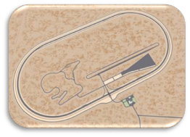
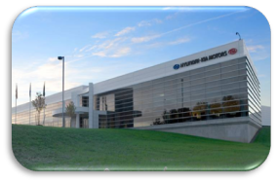
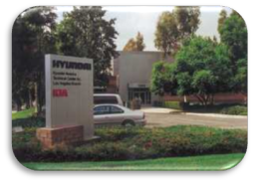
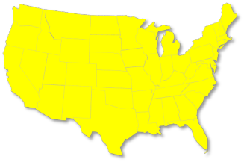
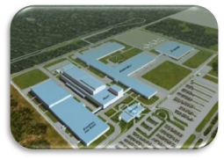
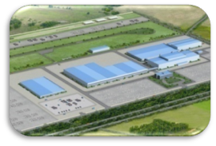
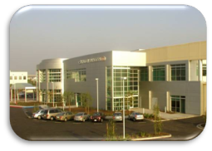
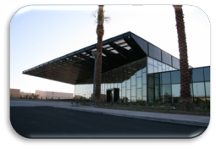
Hyundai-Kia US R&D Operations
Vehicle Durability and Performance Testing
California
Proving Grounds
- Admin / HR / ACC.
- Design Engineering
- Laboratory Testing
Powertrain
Electronics Dev.
- Planning / Regulations
HATCI
HMMA
Chino Laboratory
Support Engineering
Improvements
Quality improvement
California Emissions Testing Fuel Cell Fleet
Irvine Technical Center
& Design Studio
KMMG
Kia Design Studio
Design products for North American Market
Separate facilities to differentiate brands

Slide 3
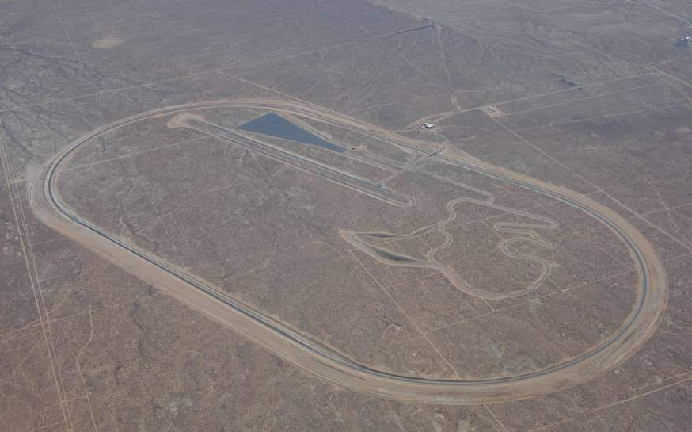
HATCI Road Test Capability
California Proving Grounds (CPG)
Site : 4,368 acres, approximately 11 square miles , over 40 miles of road and test tracks
Construction Started: 2003 Opened : 2005
Primary functions: Vehicle development, safety confirmation, quality & durability testing
Incline road
Off-road
VDA
Durability
Coast down
Material Weathering Facility
Ride/NVH road
LA freeway
Handling road
High speed oval
Cross-country

Slide 4
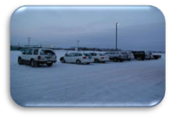
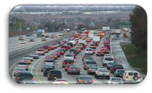
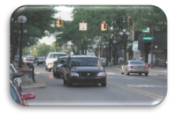
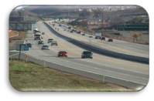
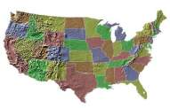
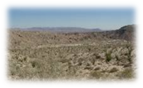
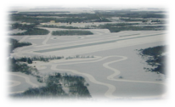
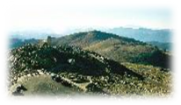
Other Places We Test Vehicle Performance
Vehicle Performance Development based on various environment : Suspension /Braking/ NVH / Audio system / HVAC
Heater, A/C development
NVH test
Brake performance test
L.A
Audio system test
Suspension Tuning & Tire test
 | ① Summer | ② Winter | ③ High Altitude
 | Death Valley, Indio desert | Minnesota | Mt. Evans
Test Items | Drivability HVAC | Engine, Braking, Heating & Driveability | Engine Startability, Climbing Performance, Braking
②
①
③

Slide 5

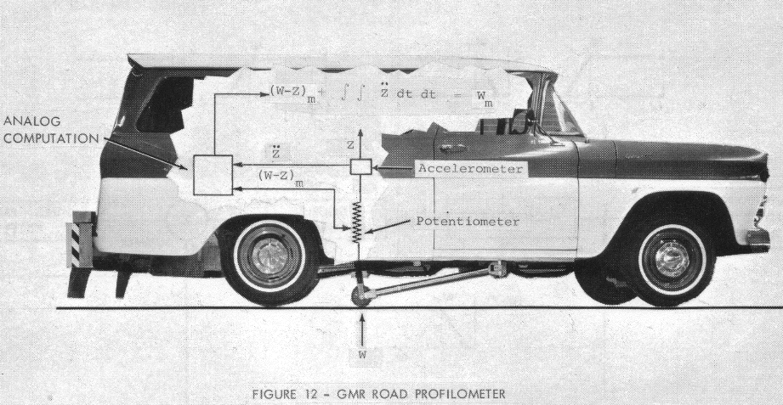
A Little History of Road Profiling
1964:
Elson Spangler and Bill Kelly of General
Motors invent the first internal profiler.

Slide 6



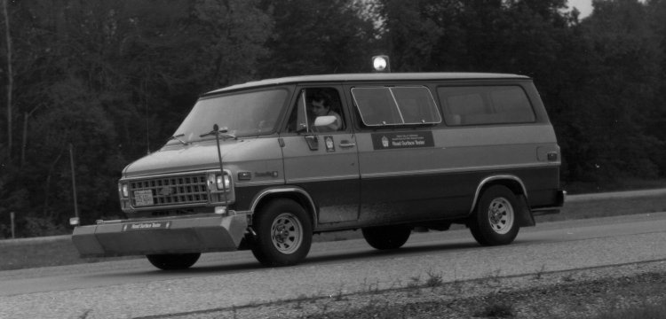
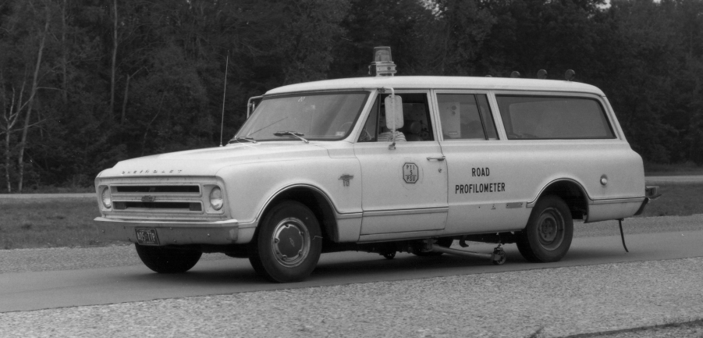
More History
Soon After:
State DOT’s begin using profilers based on the Spangler/Elson design.
  Michigan DOT and Texas DOT
  are among first to
  utilize the design.
  FHWA begins pushing
  more usage.

Slide 7

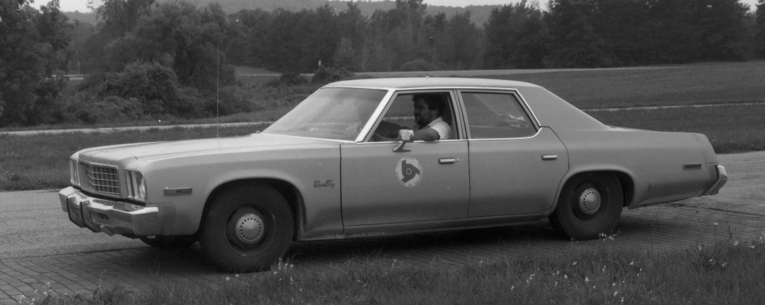
More History
Eventually:
Dave Huft builds the “South Dakota Profiler”
South Dakota hosts the
first RPUG meeting in 1986.
... and the world is never the same again

Slide 8
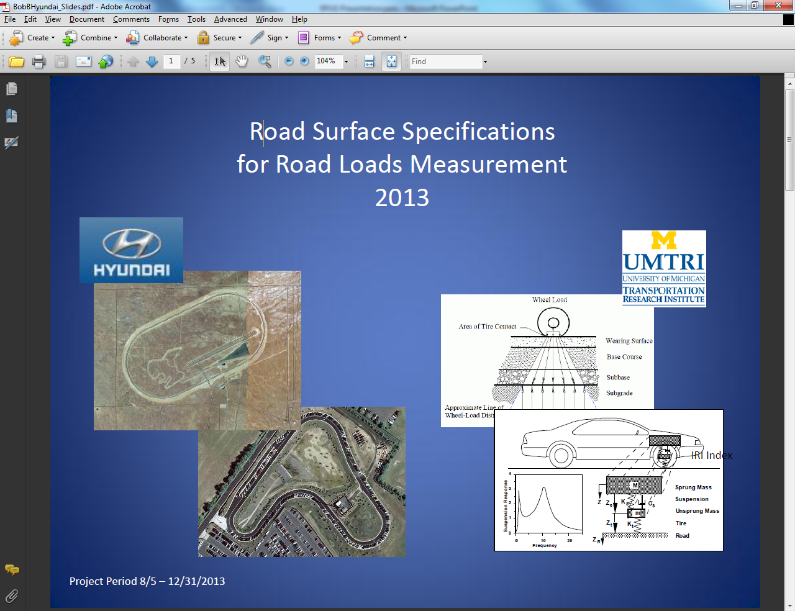
Improvements…..
International Roughness Index (IRI)
Definition:
A statistic used to estimate the amount of roughness in a measured longitudinal profile

Slide 9
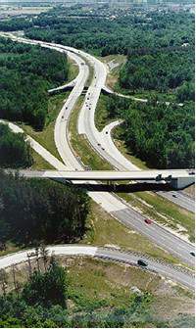

Where We Are Today
Now:
FHWA produces the Highway Performance Monitoring System (HPMS)
  Hyundai-Kia America Technical Center, Inc. (HATCI) has contracted with the UMTRI to determine the “average road surface” in the United States using the HPMS.

Slide 10
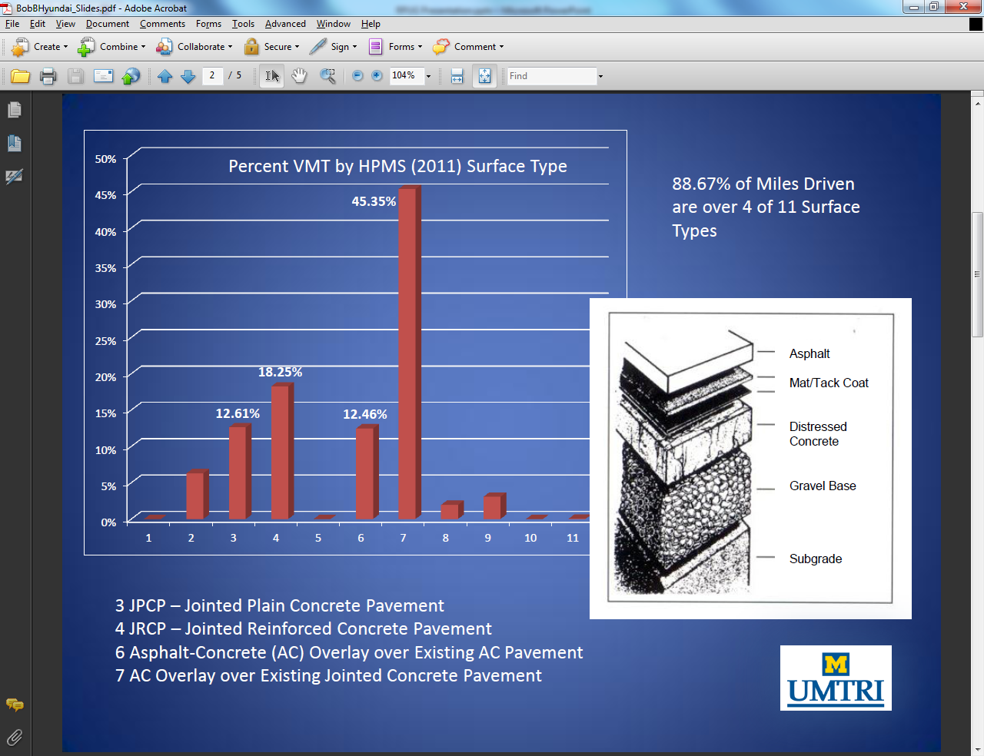
Initial Findings (Region V)

Slide 11
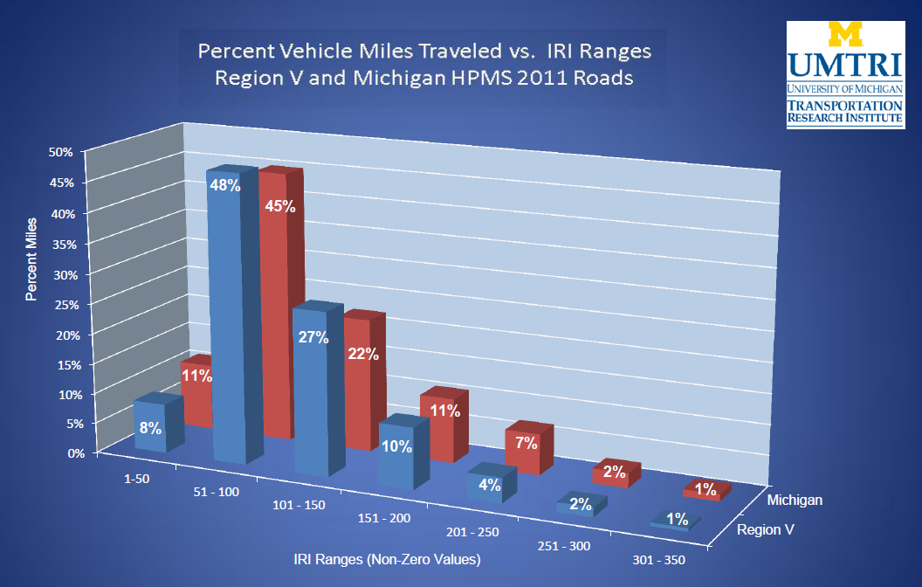
Initial Findings (Region V vs. Michigan)

Slide 12
How Is This Important To The Auto Industry?
Knowing more about road surfaces can dramatically assist vehicle designers
  NVH (Noise, Vibration, Handling)
  Knowing the frequency of operation on road “types” can influence design
  New technologies will depend on road design and infrastructure
  The auto and road industries are converging

Slide 13
Major Current Challenges
Road surfaces affect many auto issues
  Ride, handling, and vehicle safety effects are well known
    Rain and snow performance
    Vibration
    Braking
    General noise effects
  But other effects are critical as well

Slide 14
Major Current Challenges
  Road surface has a dramatic effect on fuel economy.
    Surface composition, structure, wear, expansion joints, tining, etc.
    Voice recognition is a major new technological development
      Roadway noise interferes with voice recognition
      Audio operations are degraded

Slide 15
Major Future Challenges
    Lane departure warning relies on roadway marking and/or embedded infrastructure
    Vehicle to Vehicle communication (V2V)
      Will allow vehicle monitoring for intersection crash avoidance and traffic control, but needs infrastructure
  On-road charging for electric vehicles
    Will require embedded infrastructure

Slide 16
What Can We Do?
    ENHANCING CONVERGENCE
    The more we work together now, the quicker that new technologies can be introduced to improve the driving experience, vehicle safety, and the efficiency of the transportation system as a whole

Slide 17
Credits
    Special Thanks To:
    Steve Karamihas and Michelle Barnes
    University of Michigan Transportation Institute

