Slide 1
MEASUREMENT of
FRICTION PROPERTIES

Slide 2
MEASUREMENT APPROACH
Scientific / Design /Engineering:
  Available Force from Macro-texture Component
    Measure macro-texture
  Available Force from Micro-texture Component
    Measure micro-texture
Practical:
  Combined Vehicle Control Force
  Measure Macro-texture

Slide 3
CURRENT MD METHOD
E-274 Skid Truck
  Measures Drag Force during Sliding Friction
  Primary Sensor – Tire (grooved - smooth)
  Collect Average value over 59 ft.*
  Total Test Sequence ~ 225 ft.*
  Water consumed - ~ 2 gal.
* = at 40 mph

Slide 4
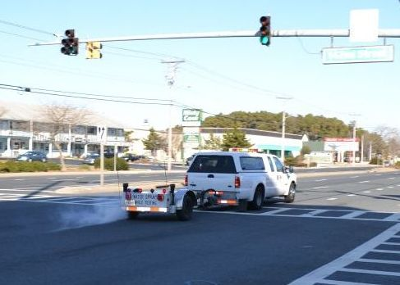
TYPICAL EQUIPMENT

Slide 5
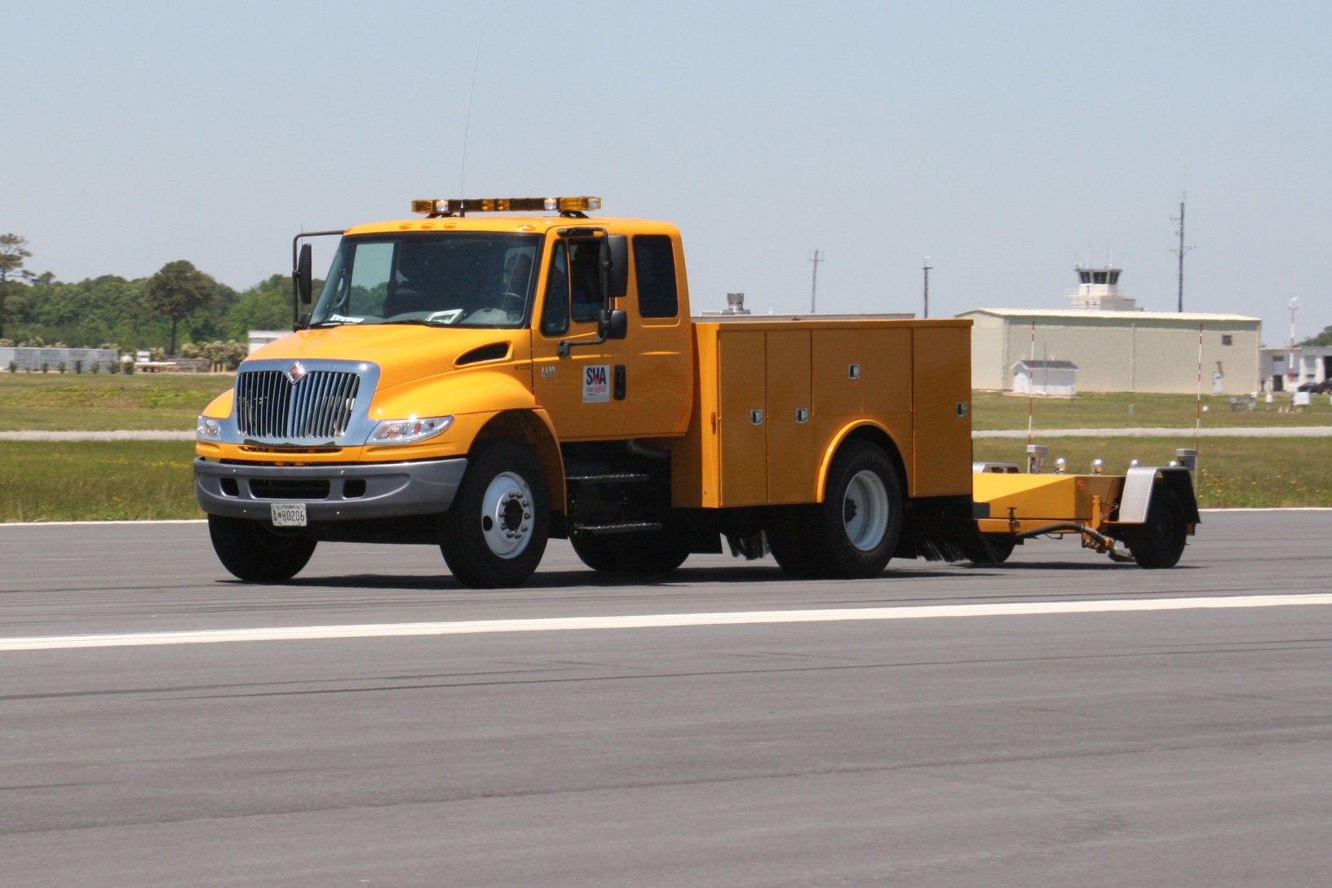
ATYPICAL EQUIPMENT

Slide 6
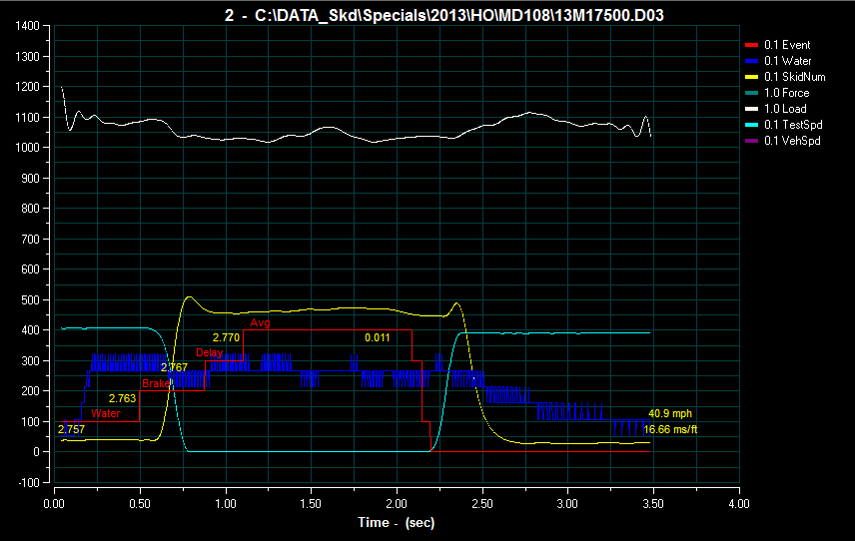
TYPICAL TEST

Slide 7
CURRENT APPLICATION
Test network every 1056 ft. if > 1 mi
Test every 528 ft. if < 1 mi.
Deemed not testable if < ¼ mile
Ribbed tire – focus on micro-texture
Test driver’s side wheel-path
Test at Speed Limit with 40 mph Maximum
Adjust Collected Value by - 0.6 SN per MPH
  (true adjustment is dependent on surface properties)

Slide 8
ISSUES
Sampling 6% - 10% of pavement
Large sample spacing:
  Water consumption
  Total test sequence time
  Lost tests at intersections etc.
Measuring “locked” friction
Test spacing too far for ramps etc.

Slide 9
WHY
Miss key pavement sections of concern:
  Ramps, Sharp curves, Traffic control areas
  Sections shorter that ¼ mile very difficult to test
Apply the limited sample resources more effectively
Increase the size of the sample (moderate)
Functional test should more closely resemble the typical vehicle application

Slide 10
LIMITATIONS
PRIMARY:
  Water ……. 400-1000 gallons
  Tire Tread …… 1/8 inch
SECONDARY:
  Braking Energy
  Mechanical System Speeds

Slide 11
SCRATCH SYSTEM
Tire Tread Width – 4” (narrower tire)
Water consumption - ~ 0.2 gals/ test
Down Force – 675 pounds (lighter trailer)
One Second Total Test Cycle
Digital Reliability Everywhere Possible
Include:
  Macro-texture Measurement
  Sub-meter GPS

Slide 12
E-274 BASED PROPOSAL
Data averaging time of 0.1 to 0.2 sec (6-12ft.)
Start averaging at 60% - 80% “lock-up”
Reduce total test time to 1 – 1.5 sec
Reduce water consumption to ~ 0.5 gal
Routine sample spacing - 0.05 mi (264ft)
Short routes and projects - 0.02 mi. (105 ft)

Slide 13
IMMEDIATE ACTIONS
Purchase a more flexible device – July 2013
  Flexible control software:
    Change test timing (percent slip, time)
    Data sample rate ?
  Improve water control:
    Rapid electric flow control
    Small accumulator for shock control ?
  Improve data processing for the increased rate
    Low noise, functional filtering
  Include macro-texture laser and GPS

Slide 14
POTENTIAL FUTURE ACTIONS
Servo driven water pump system on the trailer*
More robust braking system with sturdier axles*
Narrower test tire (full diameter) with a narrower nozzle to further reduce water requirements by ~30%
  *May be included in current device as vendor option

Slide 15
QUESTIONS?

