Slide 1
COMPARISON OF MPD VALUES FROM HIGH-SPEED LASER MEASUREMENTS WITH MPD FROM TWO STATIONARY DEVICES
Rohan Perera, PhD, PE
Soil and Materials Engineers, Inc.
Plymouth, Michigan
Larry Wiser
Federal Highway Administration
McLean, VA
RPUG 2013, San Antonio, TX

Slide 2

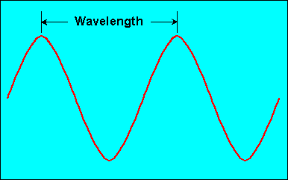
Pavement Texture (ISO)

Slide 3
Macrotexture
Friction.
Tire Pavement Noise.
Rolling Resistance.

Slide 4
Measurement of Macrotexture
ASTM E 965, Sand Patch Test, Mean Texture Depth (MTD).
ASTM E 1845, Laser Measurements, Mean Profile Depth (MPD).
ASTM E 1845 has a regression equation to estimate MTD from MPD.

Slide 5
Measurement of Macrotexture at Network Level
Single point laser sensor installed on a vehicle. Compute MPD from collected data.
Simulate a digital sand patch on 3D data (e.g., Pavemetrics LCMS Data).

Slide 6
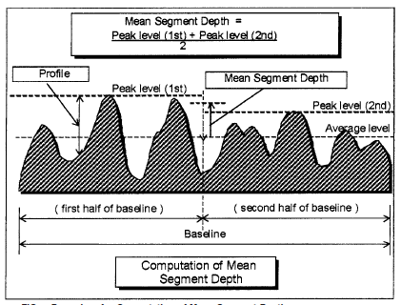
Computation of MPD, ASTM E 1845
= 100 mm
Baseline = 100 mm

Slide 7
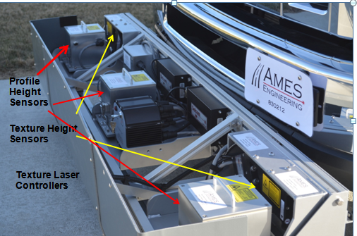
LTPP Profilers - 2013
Texture Lasers: LMI Selcom Optocator 2008-180/390, 62.5 kHz

Slide 8
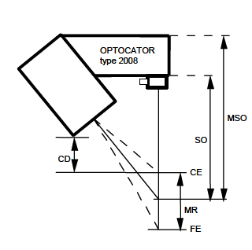
LMI Optocator 2008
From LMI-Selcom User Manual

Slide 9
Capabilities of Texture Laser
Data are sampled at 62.5 kHz and all collected data are saved.
For LTPP purposes data are decimated to obtain data at 0.5 mm intervals.

Slide 10
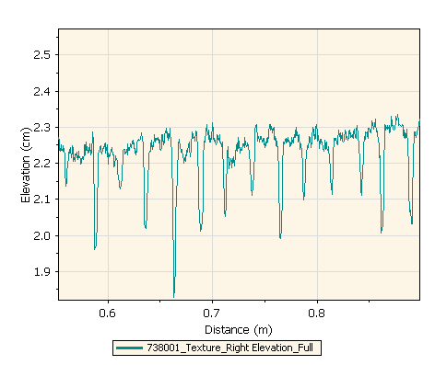
Data Collected at Concrete Section
Transverse Tines

Slide 11
Checking Accuracy of Texture Laser
Block check.
Texture Reference Disk provided by Ames Engineering.

Slide 12
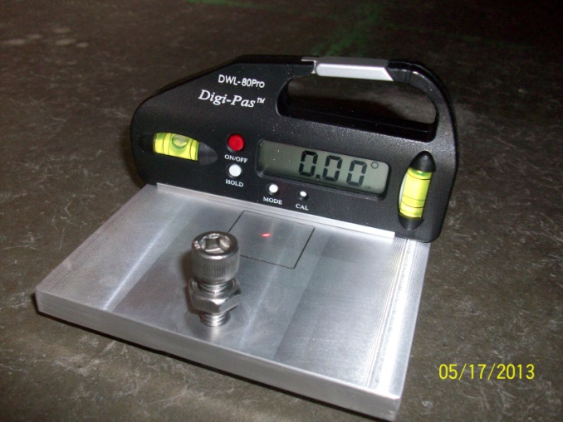
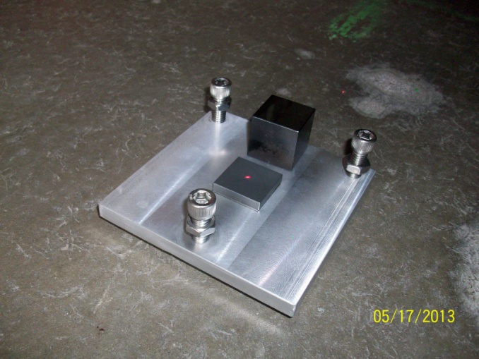
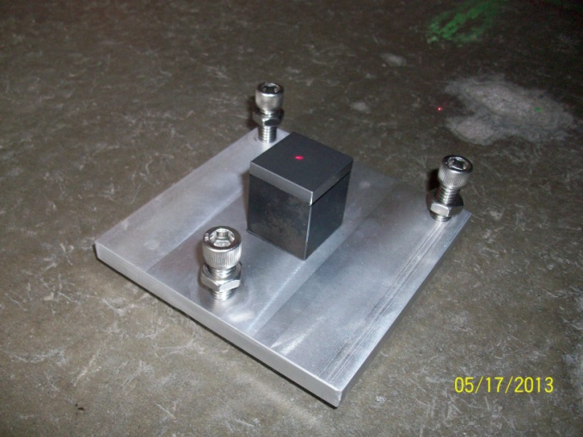
Block Check

Slide 13
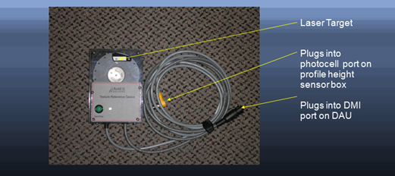
Texture Reference Disk
Machined hard disk with four steps alternating from 0.5 to 1.0 mm.

Slide 14
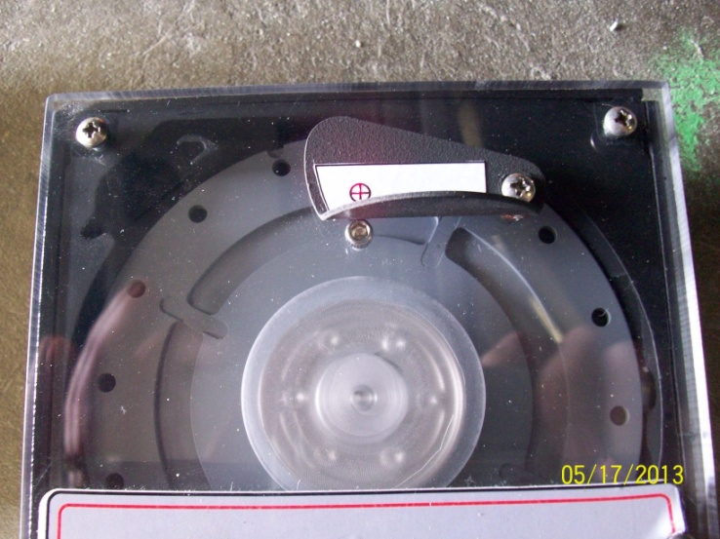
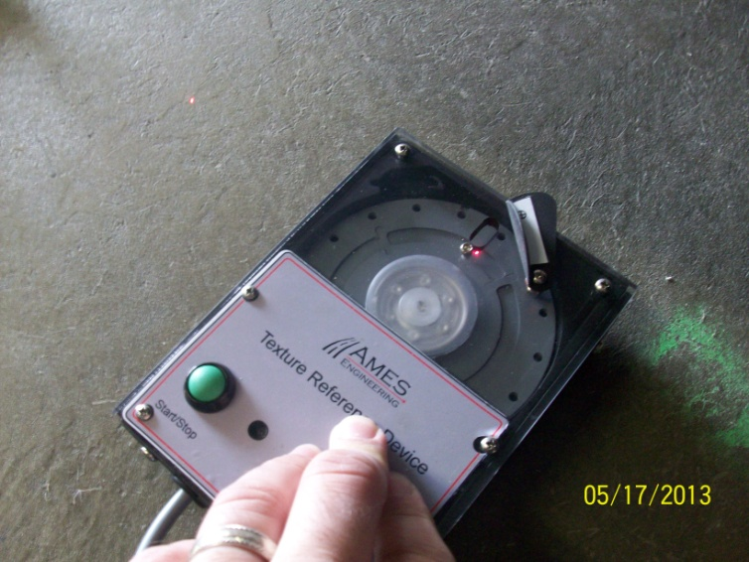
Texture Reference Disk
Disk attains a speed of 7200 rpm and starts taking measurements. Simulates a speed of 54 mph.
MPD computed from data displayed on the computer.
Theoretical MPD of Disk = 0.75 mm.
Collected data can also be viewed.

Slide 15
Comparison of MPD From High-Speed Device with MPD From CT Meter and Ames Scanner

Slide 16
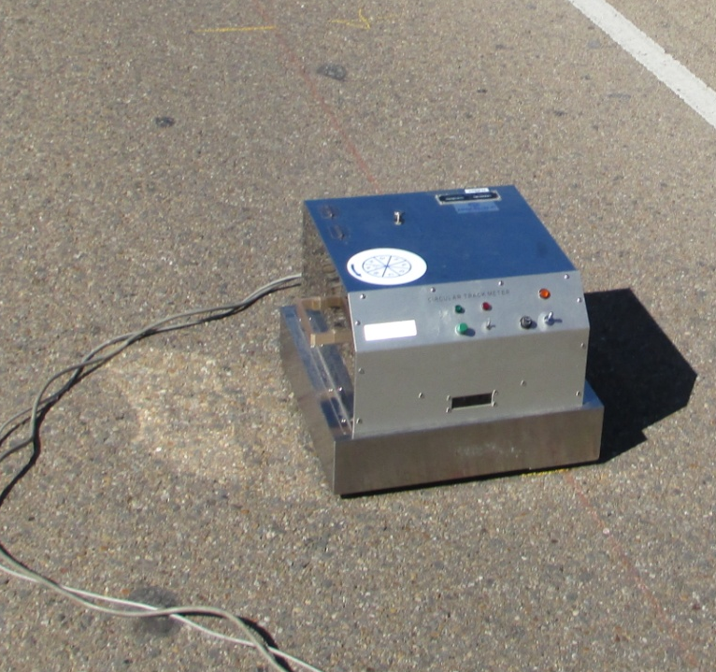
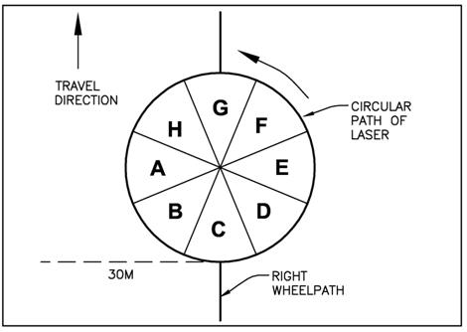
CT Meter
Sensor mounted on a rotating arm.
Follows a circular path having a radius of 142 mm.
Sample spacing = 0.87 mm.

Slide 17
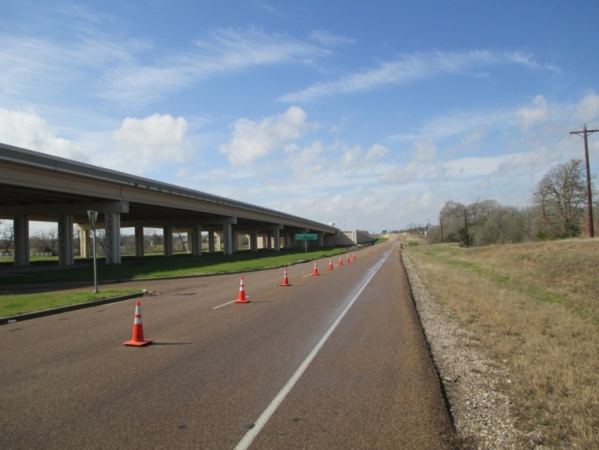
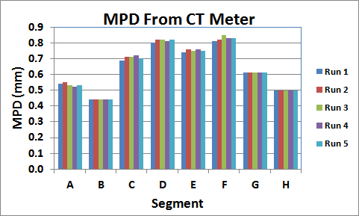

MPD From CT Meter – Repeatability Asphalt Section

Slide 18
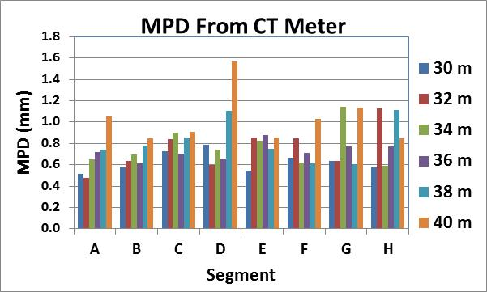
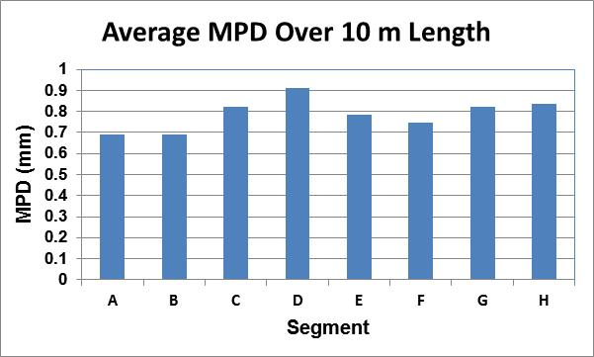
CT Meter - MPD on Asphalt Section at 2 m Intervals Along Right Wheelpath

Slide 19
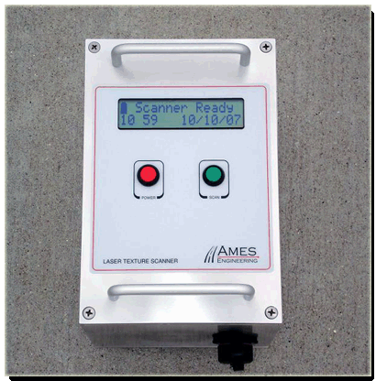
Ames Engineering Scanner
Dimensions: (Width, Height, Depth)
6” x 9” x 6”.
Laser travels 100 mm along a longitudinal path.
Was set to get 10 scans over a 75 mm width.
Sample spacing approx. 0.014 mm.

Slide 20
Analysis Procedure
Three Test Sections: Two asphalt (AC-1, AC-2), and one chip seal (CS).
CT Meter and Ames Scanner tests performed over a 10 m distance at 2 m intervals. Results averaged.
Average MPD from macrotexture data collected by high-speed device computed over same 10 m distance.

Slide 21

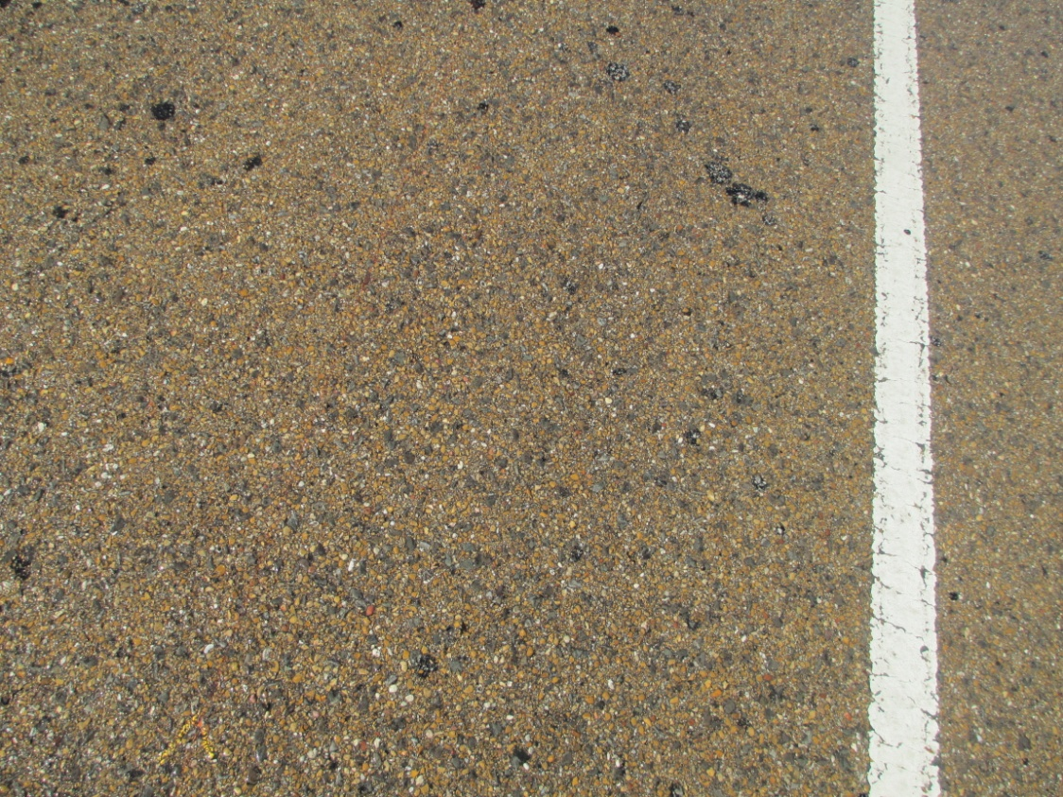
Test Section AC-1, Dense-Graded AC

Slide 22
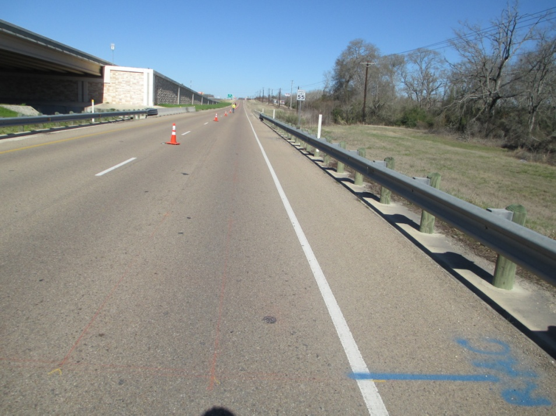
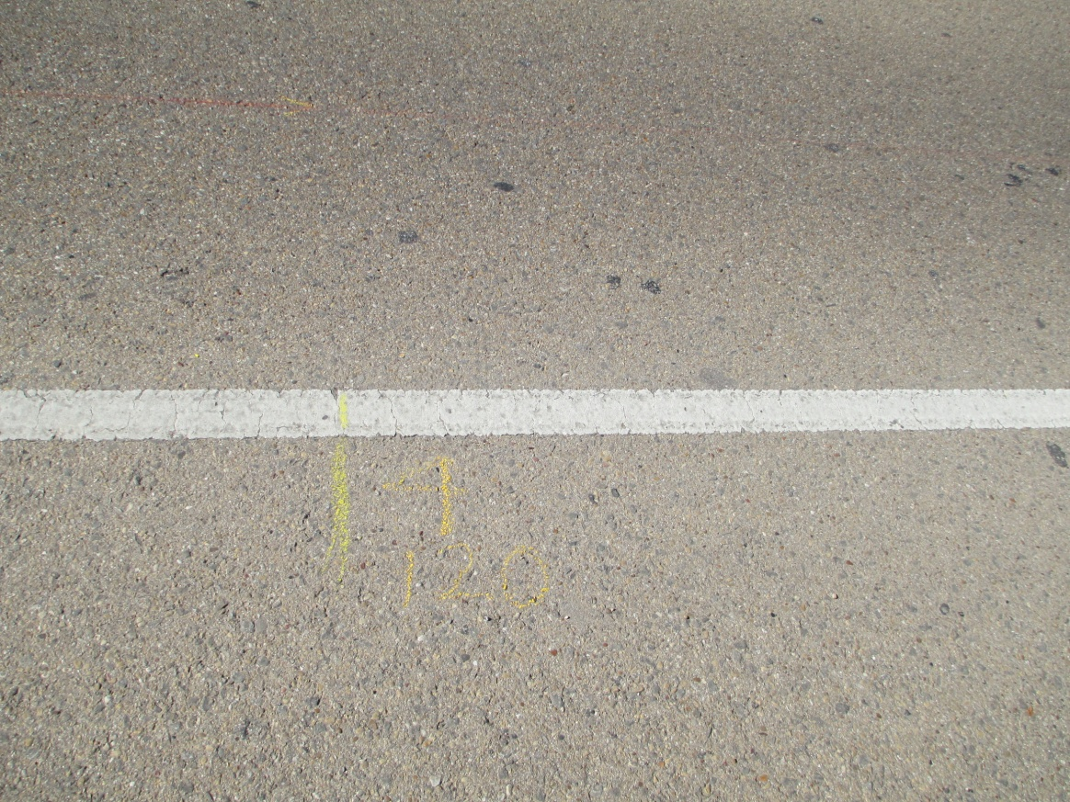
Test Section AC-2, Dense-Graded AC

Slide 23
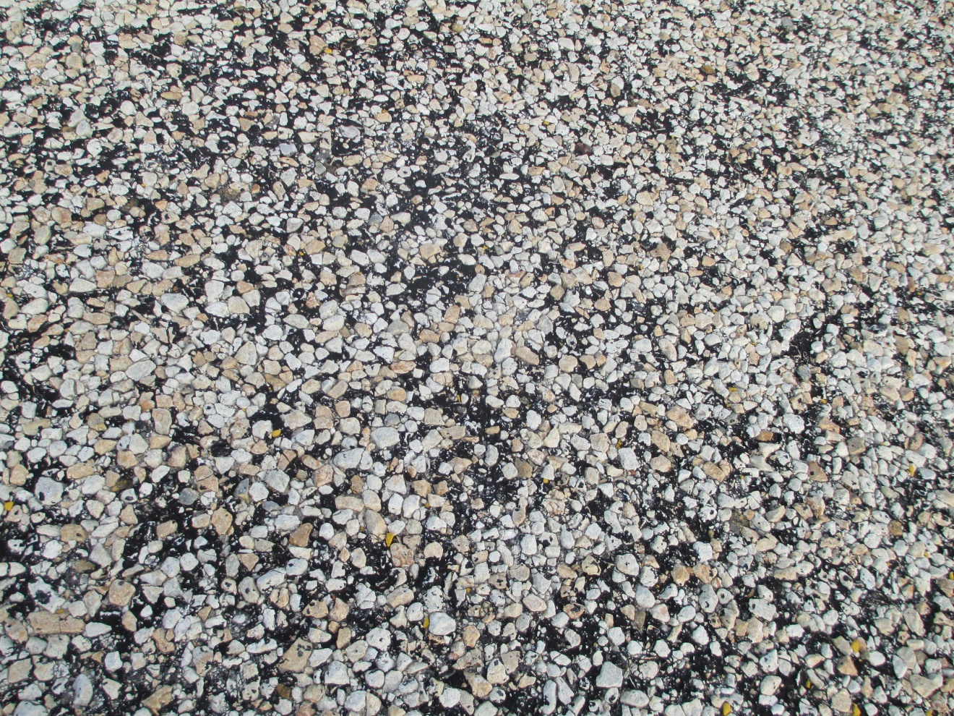
Test Section – Chip Seal

Slide 24
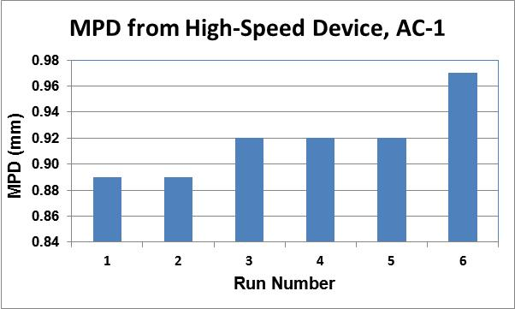
Repeatability of MPD from High-Speed Device Over 10 m

Slide 25
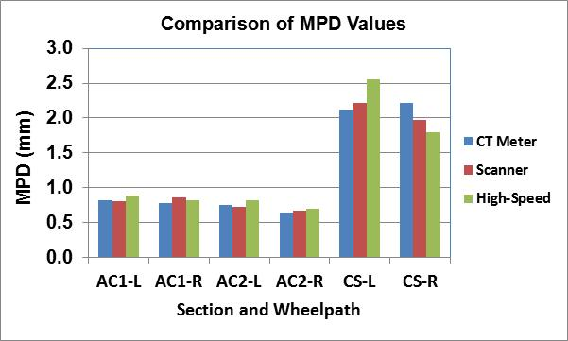
Comparison of MPD Values

Slide 26
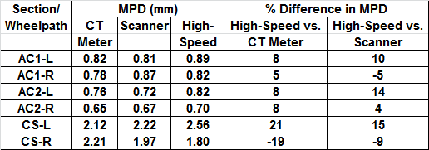
Comparison of MPD Values

Slide 27
Issues
Improved procedures for verifying accuracy of macrotexture data collected by high-speed devices is necessary.
High-frequency laser sensors may be noisy, thereby affecting MPD values.
Single spikes were noted in the macrotexture data. Robust spike detection algorithms are needed.

Slide 28
Issues
ASTM E 1845 specifies a low-pass filter to be applied on the data before computing MPD. Differences on how the low-pass filter is programmed can affect MPD values.
Need for a “standard” program to check MPD computations
Data from high-speed laser is time-based. Lower speeds means more data are collected. Speed may affect MPD.
Outlier detection scheme is needed to avoid cracks affecting MPD values.

