Slide 1



Dependency of
Coefficient of Rolling Resistance on Pavement Surface Characteristics
Richard Sohaney, The Transtec Group
Bernard Izevbekhai, MnDOT
19 September 2013

Slide 2
Acknowledgements
Transportation Pooled Fund TP-5(134)
  Minnesota Department of Transportation
  Texas Department of Transportation
  Federal Highway Administration
    Robert Orthmeyer

Slide 3
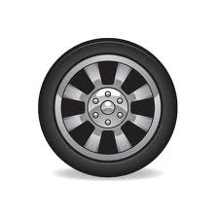
What is Rolling Resistance?
The non-inertial, non-aerodynamic, and non-skidding resistance to the interaction of vehicular tire with the road surface.
Rolling resistance
Rolling
direction

Slide 4
Percentage of Total Resistance
 | Very Low Speeds | 90 km/h | 120 km/h
Inertial Resistance | 41 | – | –
Air Resistance | 13 | 63 | 75
Rolling Resistance | 46 | 37 | 25
[Silka W.: Energochłonność ruchu samochodu, Warszawa, WKŁ 1997]

Slide 5
Rolling Resistance and Fuel Consumption
Car at 100 km/h: expends ~50% fuel to overcome RR.
Truck at 80km/h: expends ~40% of fuel to overcome RR.
Overall vehicle average: ~25% of fuel consumption is expended on RR.
10% decrease in RR results in a 2 to 3% reduction in fuel consumption.

Slide 6
Why Care about Rolling Resistance
Effect of a 10% decrease in RR:
  Energy savings –
    2 to 3% reduction in fuel consumption.
    Up to $12.5 billion fuel cost savings per year.
  Reduced emissions
    250,000,000 vehicles (USA)
    CO₂ emissions reduced by 100,000 tons per day.

Slide 7
Objectives of this Study
Investigate pavement surface characteristics that influence rolling resistance.

Slide 8
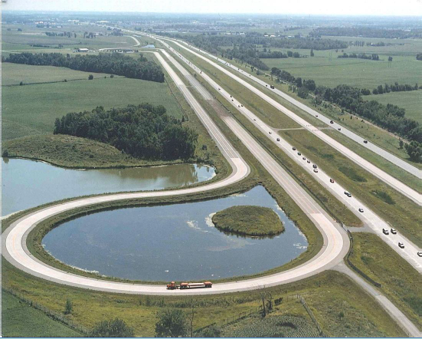
Method
Use test data from MnROAD.
  Rolling resistance study in 2011.
  Surface characteristic data on MnROAD test cells.
Multi-variable linear regression analyses.

Slide 9
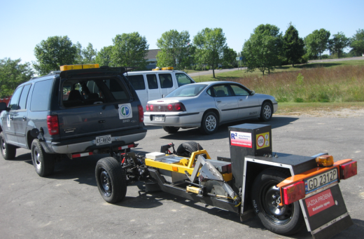
Rolling Resistance Test Trailer
One-ton
Test tire enclosed.
Variable load.
Compensates for pavement smoothness and other factors.
Jerzy Ejsmont, Technical University of Gdańsk (TUG), Poland

Slide 10
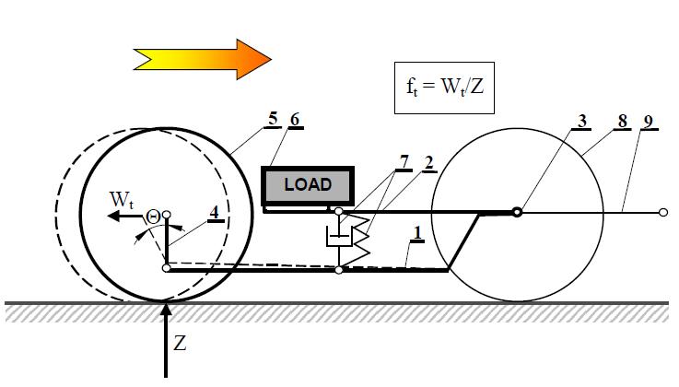
Principle of Operation
1-frame
2-loading system
3-axis of frame and loading device
4-measuring arm
5-test wheel
6-adjustable load
7-damper and spring
8-front wheels
9-tow hitch

Slide 11
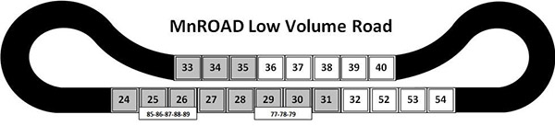

MnROAD Test Cells
Two roads
  54 test cells
  Two lanes in each cell
  108 data points
MnROAD Mainline

Slide 12
MnROAD Pavements
Asphalt
  Ultra thin bonded wearing course
  Chip seal
  4.75 mm taconite
  12.5 mm dense-graded superpave
  Porous HMA
  Dense-grade plug fog seal
PCC
  Transverse and longitudinal tine
  Broom drag
  Artificial turf drag
  Conventional diamond grind
  Ultimate diamond grind
  Innovative diamond grind
  Pervious
  Exposed aggregate

Slide 13
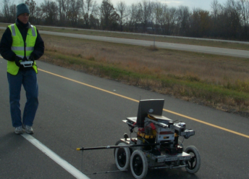

MnROAD Surface Characteristics
Texture
  Profile depth
Roughness
  IRI, ASTM E-950
Friction
  ASTM E-247

Slide 14
Additional Surface Characteristics
Texture variables – 105 total
  RMS, Skew, Max peak/valley/height
  Bearing ratio curve: Rpk, Rk, Rvk, Rktotal
  3rd octave wavebands from 3.15 to 160 mm
  Lumped spectral bands
  Statistical: 10th, 50th, 90th percentile
Unevenness – 31 total
  3rd octave wavebands from 0.08 to 25 meters
  Lumped wavebands

Slide 15
Database
Rolling resistance data
Database
Regression analyses
Surface characteristic data
Texture
Roughness
Unevenness
Friction

Slide 16
Multi-Variable Linear Regression
General equation
  Where
    Variable_{i} = texture, unevenness, or friction
    C_{i} = coefficients
$$CRR=C_{1}×{Variable}_{1}+C_{2}×{Variable}_{2}+C_{3}×{Variable}_{3}+C_{4}$$

Slide 17
Criteria for Good Fit
R-squared large.
Valid results:
  P-values (significance level) ≤ 0.05.
  Sign of coefficients meets engineering expectations.

Slide 18
Analyses by Groups
By pavement type (separate analyses)
  Asphalt
  PCC, non-grind
  PCC, grind
By road (using qualitative variable)
  Mainline
  Low Volume Road

Slide 19
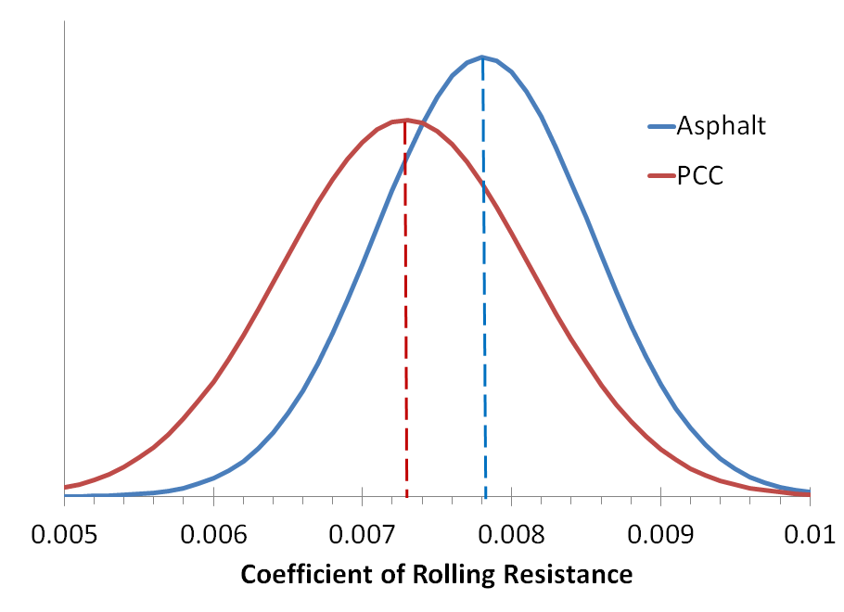
CRR Distributions
Asphalt
  Mean CRR = 0.00781
PCC
  Mean CRR = 0.00729

Slide 20
Variable Combinations
Single variable
Two variable
  Traditional MPD and IRI
  Texture and unevenness
  Texture and friction
  Two texture variables
Three variable
  Texture, unevenness, and friction
  Two texture and one unevenness

Slide 21
Number of Variable Combinations
Example: 1 texture and 1 unevenness variable
  105 texture variables
  31 unevenness variables
  3255 combinations; a regression analyses for each
Number of valid results
  Asphalt: 222
  PCC, non-grind: 233
  PCC, grind: 101
$$CRR=C_{1}×{Texture}_{1}+C_{2}×{Unevenness}_{2}+C_{3}$$

Slide 22
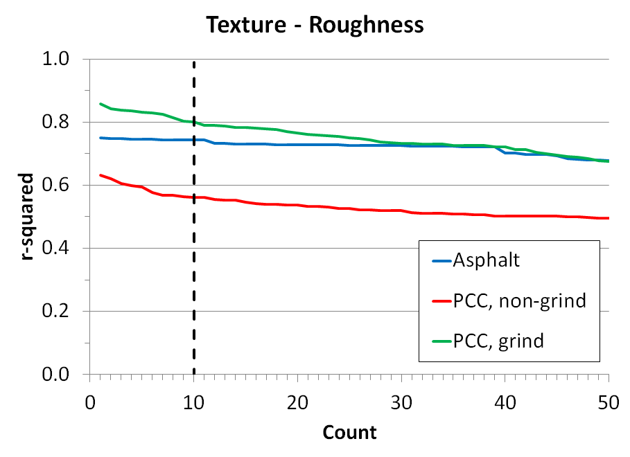
r-Squared Graph
Texture and Unevenness Analyses

Slide 23
r-Squared vs. Dependent Variable
Texture and Unevenness Analyses: Asphalt

Slide 24
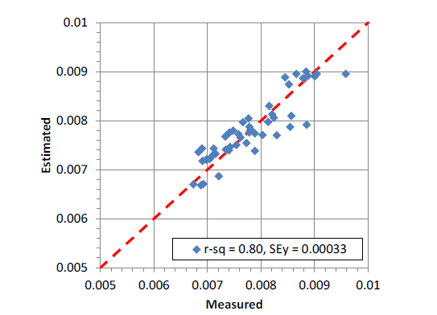
Sample Analysis – Asphalt
Single variable
  “Lumped” texture level in the 3.15 to 50 mm bands
R-squared = 0.80

Slide 25
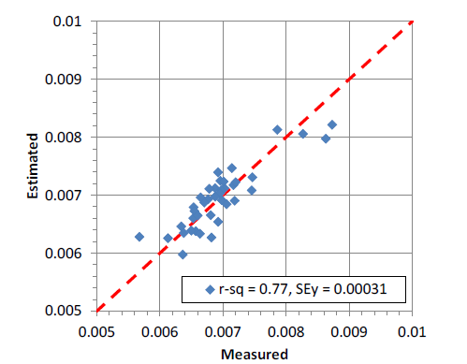
Sample Analysis – PCC, Non-Grind
Three variables:
  “Lumped” texture level in the 50 to 160 mm bands.
  Transverse skew.
  Unevenness level in the 1.25 m band.
R-squared = 0.77

Slide 26
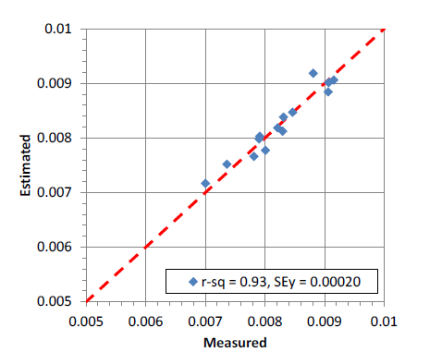
Sample Analysis – PCC, Grind
Three variables:
  “Lumped” texture level in the 3.15 to 50 mm bands
  Transverse skew.
  Unevenness level in the 2.0 m band.
R-squared = 0.93

Slide 27
Skew
Statistical metric
  3rd moment about the mean.
Distinguishes between positive and negative oriented texture.

Slide 28
Regression Analysis using MPD and IRI
Poor regression results with MPD and IRI.
  R-squared values < 0.5
  P-values >> 0.05
  Negative coefficients
  Or, some combination of these.

Slide 29
Conclusions
Many combinations of surface characteristic variables can predict CRR.
Variables that predict CRR are different between asphalt and PCC.
Traditional texture depth (MPD) and roughness (IRI) metrics are not optimum variables to predict rolling resistance.
TUG returning next year for additional RR measurements.

Slide 30
Conclusions – Asphalt
One texture variable adequate
R-squared up to 0.80
Strong dependency on:
  Macro texture in the 3.15 to 50 mm range
Adding more variables reduced the quality of the regression analyses.

Slide 31
Conclusions - PCC
Three variables provide best fits
  Two texture + one unevenness
R-squared values
  PCC, non-grind: up to 0.78
  PCC, grind: up to 0.93
Strong dependency on:
  Macrotexture
  Skew

