Slide 1
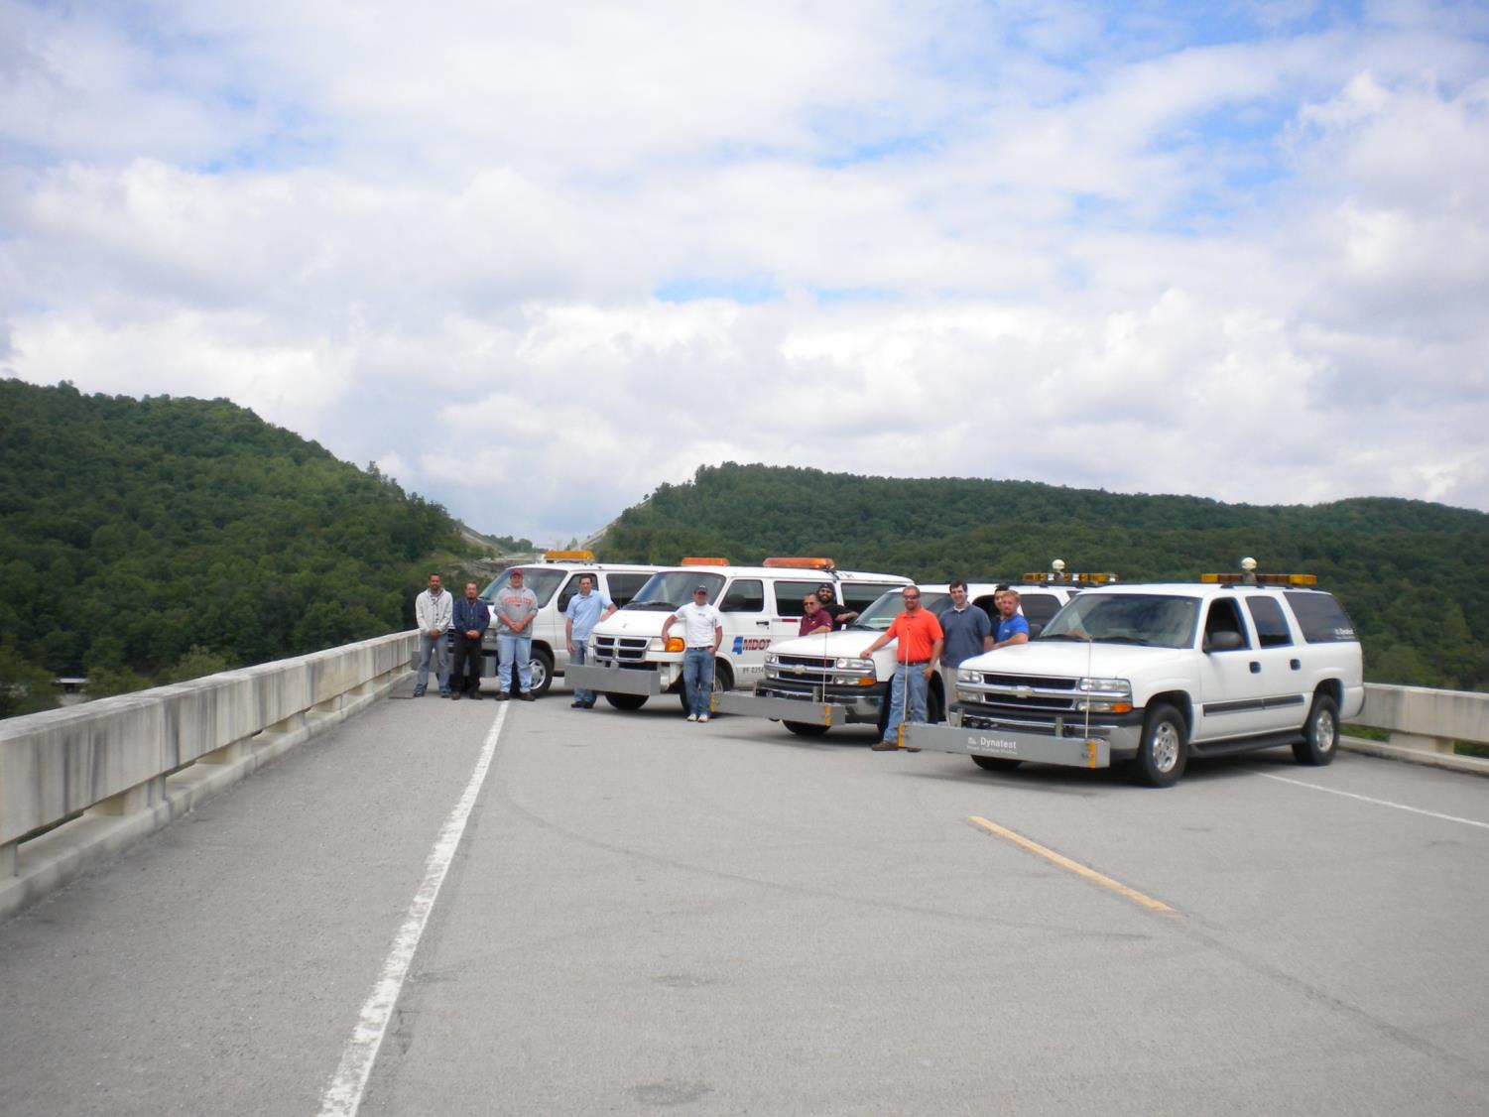


Use of Probe Vehicles to Measure Road Ride Quality
Samer W. Katicha
Senior Research Associate,
Center for Sustainable transportation Infrastructure

Slide 2
Outline
Smoothness for asset management
Probe vehicles
The experiment
  IRI calculation from profile
  IRI calculation from vertical acceleration measurements
  Sensitivity analysis
Conclusions

Slide 3
Smoothness for asset managment

Slide 4

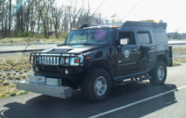
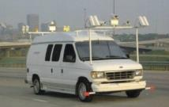
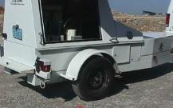
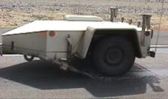
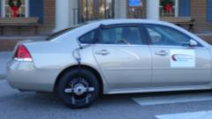
Infrastructure Condition/ Performance Indicators → Pavements
→ Pavements
Service and User Perception
Physical
Condition
Structural Integrity / Load-Carrying Capacity
Safety and Sufficiency
Environmental Impact
Serviceability
(PSI, IRI)
Distress
(PCI)
Deflection
(FWD)
Friction (FN)/ Macrotexture
Tire/Pav. Noise
Rolling Resistance

Slide 5
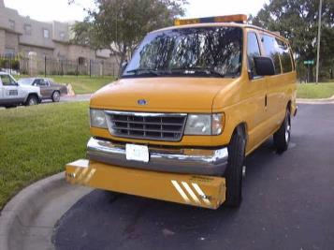
Asset Management
Strategic level
  Performance monitoring
Network level
  Pavement management
Project level
  Smoothness Specification
  Research → LTPP

Slide 6
Information Quality Levels
HIGH LEVEL DATA
Strategic
Level
Business Processes
System
Performance
IQL-5
Information Quality Levels
Performance
Monitoring
Network
Level
IQL-4
Planning and
Structure
Condition
Performance Evaluation
Program Analysis or
IQL-3
Ride
Distress
Friction
Detailed Planning
Project
Level
Project Level or
IQL-2
Detailed Programming
IQL-1
Project Detail or
Research
LOW LEVEL DATA
Notes:
The various IQLs requires different levels of detail and quality in the collected data to support the corresponding decision-making processes, which translate into different methods and frequencies of data collection. Therefore, it is imperative for the determination of data needs to pre-specify the decision level of interest.
The tailoring of the data collected for effective decision-making within the decision level can lead to more specific and focused data collection efforts. This is illustrated in the following section for the project selection decision level.
This plot was adapted from: Bennett, C. and W.D. Paterson, "A Guide to Calibration and Adaptation of HDM-4," in The Highway Development and Management Series, The World Bank, Washington, D.C., 2000.

Slide 7
Probe Vehicles

Slide 8
Can we use probe (or regular) vehicles for road infrastructure health monitoring?
At least for supporting high-end
strategic- and network-level decisions?

Slide 9
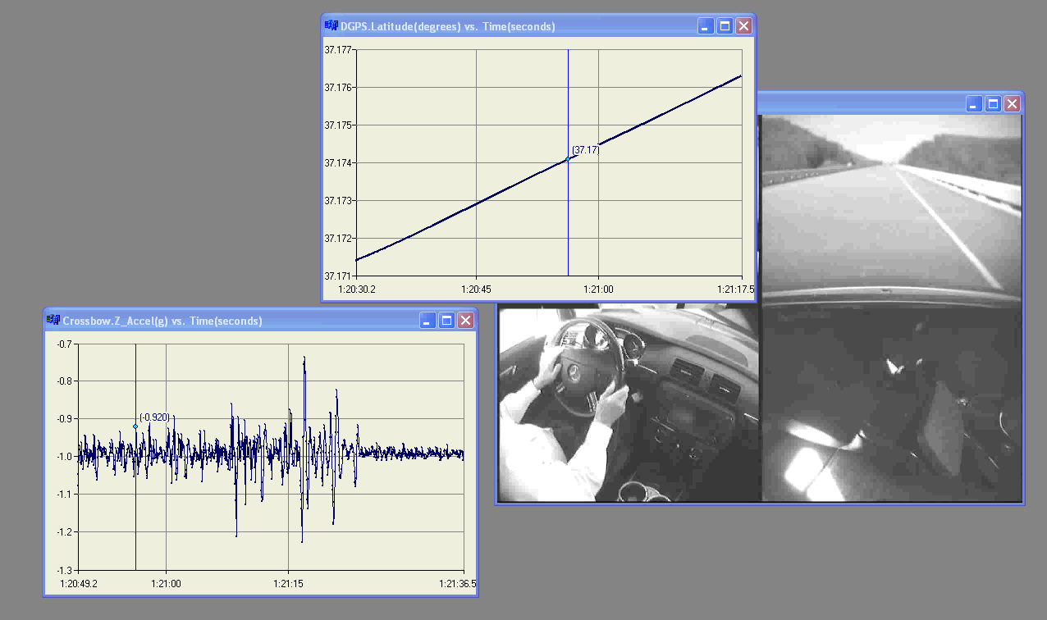
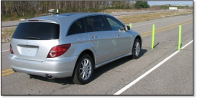



Pavement Assessment and Management Applications Enabled by the Connected Vehicles Environment – Proof-of-Concept
Objective: To use data collected from probe vehicles to extract information that could be used to remotely and continuously determine
road infrastructure health

Slide 10
The experiment

Slide 11
Profile and Acceleration Data
Profile data:
  Collected at the Virginia Smart Road
  Every 30 mm (1.2 in)
Probe vehicle acceleration data:
  Collected at the Virginia Smart Road
  Every 2100 mm (7 ft)

Slide 12
Data Sampling Problem

Slide 13

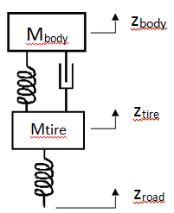
Quarter Car Model
k_{b}
C_{b}
k_{t}

Slide 14
Quarter Car Model

Slide 15
Accuracy of Numerical Calculation

Slide 16
The Probe Vehicle
2007 Ford Fusion
Car parameters:
  Same as golden car
  Close enough
Test Speed:
  50 mph

Slide 17
IRI Calculation

Slide 18
IRI Comparisons
Calculated IRI:
  Follow the same trend
  Sample over 2 m makes a difference
Problems with quarter car model:
  Probe vehicle acceleration results from the full car response
  Approximate full car with average of profile felt by the four wheels

Slide 19
“Full Car” IRI

Slide 20
Sensitivity Analysis (Sampling)

Slide 21
Sensitivity Analysis (Quarter Car Parameters)

Slide 22
Sensitivity Analysis (Sampling)
Suspension Stiffness
Suspension Damping
Tire Stiffness
Mass Ratio

Slide 23
Conclusions
Same IRI trend between probe vehicle and profiler:
  Effect of data sampling
  Effect of full vs. quarter car
  Effect of probe vehicle car parameters
Use of the data:
  To much uncertainty/variation for detailed analysis
  Maybe useful for strategic level

Slide 24

Blacksburg, VA

