Slide 1
Sidewalk Roughness Standards Development
Jon Pearlman
Human Engineering Research Labs
Assistant Professor @ Pitt
Research Biomedical Engineering @ VA

Slide 2
Human Engineering Research Labs
Mission: To continuously improve the mobility and function of people with disabilities through advanced engineering in clinical research and medical rehabilitation.
Personnel: clinicians (md, ot, pt) & engineers (ME, EE, CS, BioE)
Facilities: 30,000 SqFt (office space, clinical space, fab facility)
Funding: VA Center of Excellence, NSF, NIH, Dept of Ed., etc.
Major Activities: Clinical & technological interventions to improve the lives of PWD.

Slide 3
Motivation

Slide 4
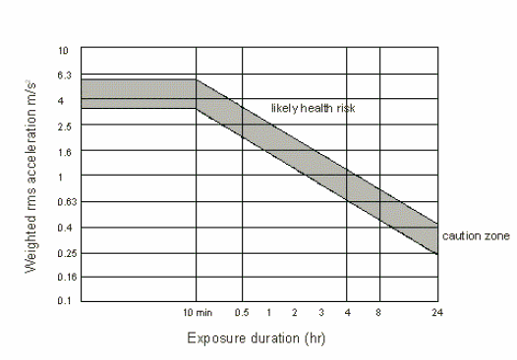
Health Motivation (’90s)
WC users are twice as likely to experience back and neck pain compared to the ambulatory population.
  60% of WC users report neck pain & discomfort
  Postural issues are common among WC users
Vibration Exposure Standards (ISO 10326 & 2631)
  Provide Measurement techniques
  Provide Exposure Thresholds

Slide 5
Related Research
Roadloads (Van sickle ‘94,’96, ‘97, ’00,’04)
  Developed instrumentation to measure reaction force at caster and propulsion wheels of MWC & recorded data in-lab and in-home & during wheelchair testing.
Seating System Influence (DiGiovine 2000 & 2003)
  Influence of seating system on comfort and vibration exposure in-lab human trials
ICPI/BIA (Wolf, Cooper, Pearlman 2004 & 2007)
  Influence of surface features on vibration exposure
Suspension (MWC: Kwarciak; PWC: Wolf, 2008)
  Influence of suspension system on vibration exposure
Influence of Cushion (Pearlman, Garcia & Cooper, 2011)
  Characterization of the WC cushion transmissibility
Community Vibrations (Pearlman, Garcia & Cooper, 2012)
  Evaluation of MWC vibration exposure in the community
Notes:
Interlocking Concrete Pavement Institute,
Brick Institute of America

Slide 6
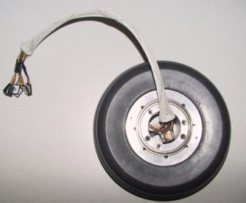
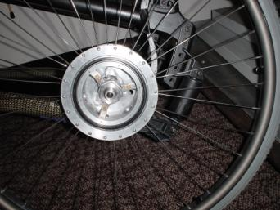
Roadloads
Research Question: What levels of vibration occur during WC use?
Methods
  Protocol: subject propel through obstacle course & in the community
  Dependent variables: reaction force at wheels and accelerations entering the body.
  Subjects: 16 MWC users over obstacle course & community, test-dummy during WC testing.

Slide 7
Roadloads (2)
Results
  Mobility Course Data: Accelerations at head & WC frame exceeded fatigue-decreased proficiency boundary.
  Community Data: Accelerations at WC frame greatly exceeded fatigue-decreased proficiency boundary
Conclusion: Vibration levels are above safe and comfortable levels and may contribute to injury.

Slide 8
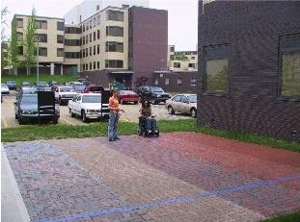
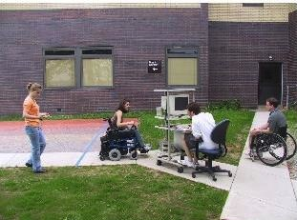
ICPI/BIA
Research Question: How do surface characteristics of outdoor pathways influence vibration exposure?
Methods
  Protocol: traverse over sidewalk surfaces at 1m/s & 2m/s (PWCs only)
  Independent Variables: surfaces (poured concrete + 8 BIA/ICPI surfaces) & device (PWC & MWC)
  Dependent Variables: Acceleration & Dose Value
  Subjects: 10 able-bodied

Slide 9
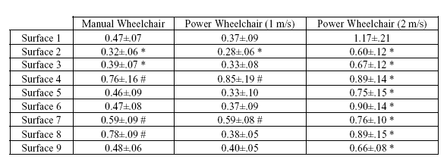
ICPI/BIA (2)
Results
  ICPI/BIA surfaces can result in lower exposure than poured concrete
  Large bevel → increased accelerations
  90deg herringbone better than 45 deg herringbone pattern
Conclusion: Surface design important, influential and have measurable effect on vibration exposure to WC riders.
45 deg
90 deg

Slide 10
Vibrations in the Community
Research Question: what are the levels of community exposure over long periods of time?
Methods:
  Protocol: instrument and collect exposure data for > 2 weeks.
  Independent Variable: WC type (rigid, folding, suspension)
  Dependent Variables: acceleration, dose, distance traveled
  Subjects: 37 full-time MWC users

Slide 11
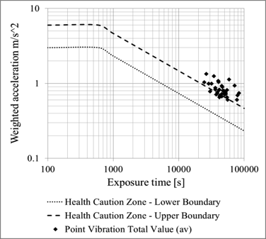
Vibration in the Community (2)
Results
  Exposure is mostly within or above caution zone
  Results insensitive to WC type
Conclusion: WC riders nearly always exposed to risky levels of vibration
 | Health Caution Zone
Site | % Below | % Within | % Above
Seat | 0 | 30 | 70
Back | 3 | 80 | 17

Slide 12
Regulations: ADA/ABA
ADA/ABA
  “physical or mental disabilities in no way diminish a person’s right to fully participate in all aspects of society…”
  “to provide a clear and comprehensive national mandate for the elimination of discrimination against individuals with disabilities and to provide clear, strong, consistent, enforceable standards addressing discrimination against individuals with disabilities.”
Notes:
ADA: amercians with disabilities act (1990)
ABA: architectural barriers act (1968)

Slide 13


ADAAG
Surfaces should be stable, firm & slip-resistant
Running slope: 1:20
Cross-slope: 1:48
Level changes: ¼”or ½” with bevel
Surface Roughness
Notes:
ADA/ABA Accessibility Guidelines

Slide 14
Goals of A/B Project
  Characterize relationship between surface roughness and user-response
  Develop ‘threshold’ roughness which is both comfortable and safe for users
  Promote threshold and relevant measurement techniques through publications and standards: A/B Website, ASTM Standards, etc.
User Response
Roughness Threshold
Roughness

Slide 15
Timeline
Y1: Oct ‘10 – Sept ‘11
  Literature Review
  Study design
Y2: Oct ‘11 – Sept ‘12
  Data collection (2/3 complete)
Y3: Oct ‘12 – Sept ‘13
  Data collection complete
  Standard Development

Slide 16
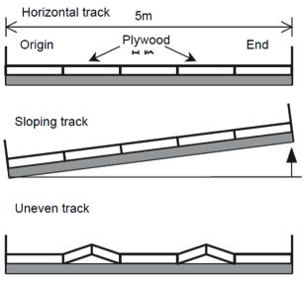
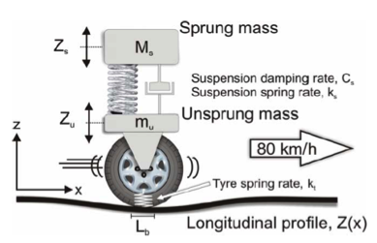
Literature Review
Background Information Gathered
  Consequences of vibration exposure
  Roadway roughness measurement & analysis techniques
  ADAAG topics relevant to sidewalk roughness
  Wheelchair-related work within above topics
Analysis Techniques | Advantage | Disadvantage
International Roughness Index (IRI) | Internationally recognized, stable, portable, linear | Long measures don't allow localized detail
Power Spectral Density (PSD) | Describes types of roughness by using wavelengths and amplitudes | Long measures don't allow localized detail
Present Serviceability Index (PSI) | High level of precision and attention to detail | Subjective Measurements, Requires many man-hours to complete

Slide 17
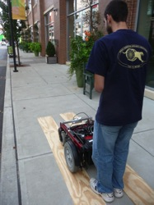
Study Design
  Intervention: subjects propel over surfaces
  Outcomes: subjective feedback (ASTM 1927), acceleration, roughness index
  Analysis: correlations between outcome variables

Slide 18
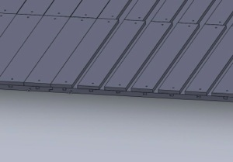
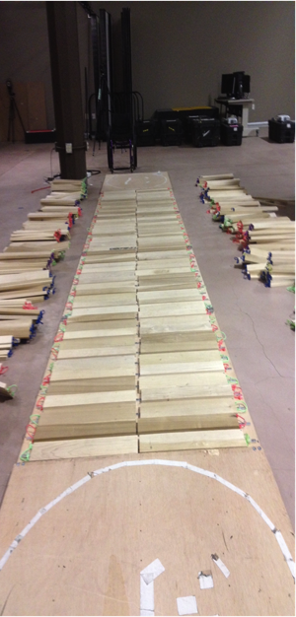
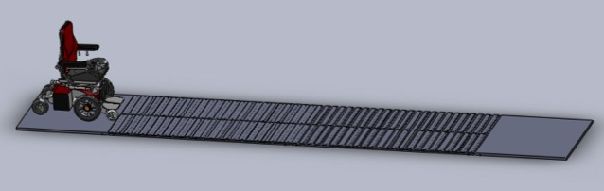
Simulated Surfaces
Wooden runway
Surface | Roughness Index (in/ft) ⁺: | Crack Frequency (in) ⁺: | Crack Width (in) ⁺:
1 | 0.20 | No cracks | 0
2 | 0.29 | 12 | 0.80
3 | 0.36 | 8 | 0.80
4 | 0.53 | 12 | 1.25
5 | 0.53 | 4 | 0.80
6 | 0.66 | 8 | 1.25
7 | 0.84 | 8 | 1.55
8 | 1.01 | 4 | 1.25
9 | 1.36 | 8 | 2.00

Slide 19
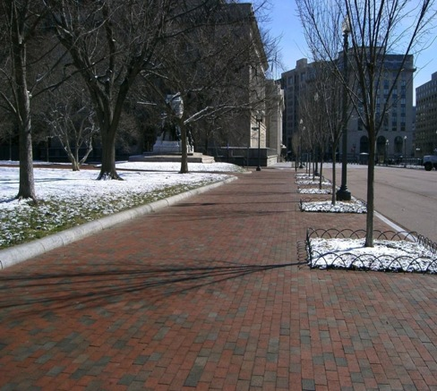
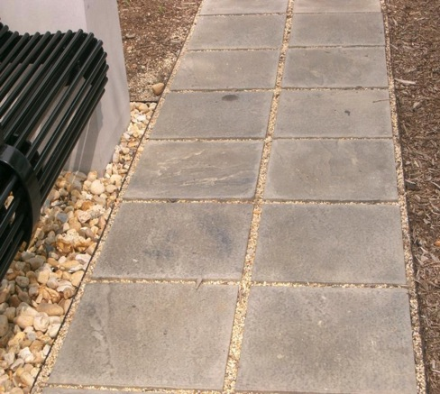
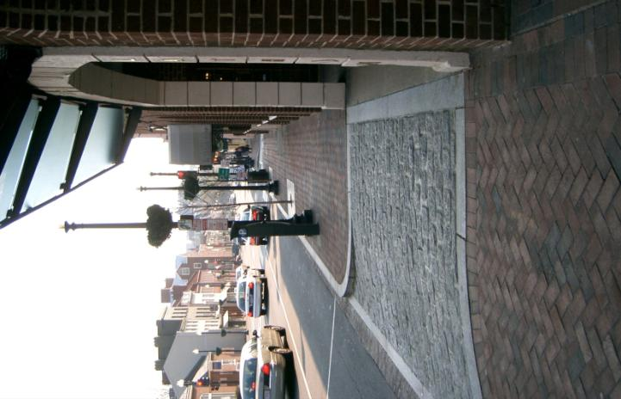
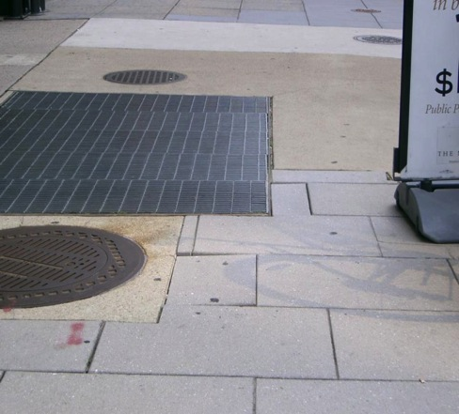
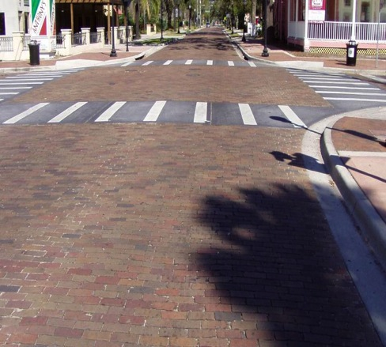

Community Surfaces
Notes:
Surfaces will be selected based on location of data collection

Slide 20
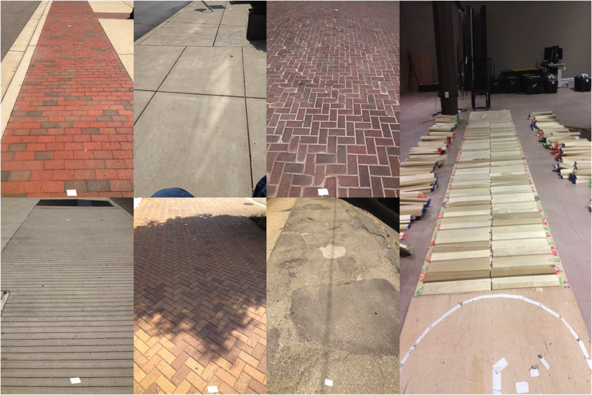
Research Protocol
Informed Consent (20 min)
Demographics Questionnaire (30 min)
Simulated Surfaces (9) Driving (60 min)
Outdoor Surfaces (6) Driving (60 min)
Driving Protocol:
  Drive over each surface 3 times
  Answer Subjective Questionnaire

Slide 21
Research Progress
54 Subjects
  40 males; 14 females
  29 manual wheelchairs; 25 power wheelchairs
85% reported spending >6hrs/day in wheelchair
45% of subjects were unsatisfied with the pathways on which they typically travel
  Damaged/Warped was the biggest complaint

Slide 22
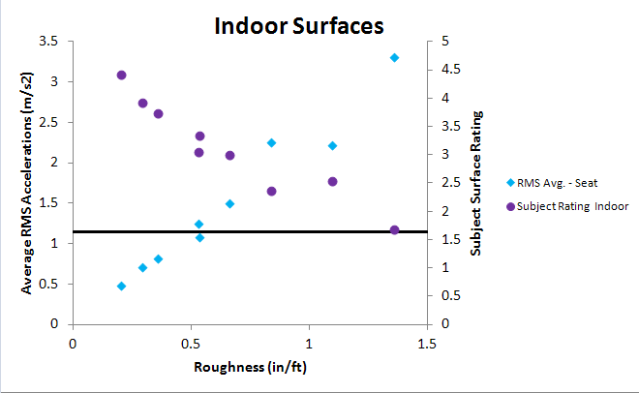
Results

Slide 23
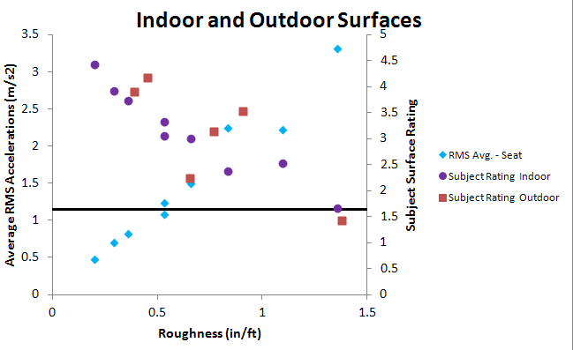
Results

Slide 24
How We Characterize Surface Roughness
  Where the pathway measurement tool (PathMET) comes in

Slide 25
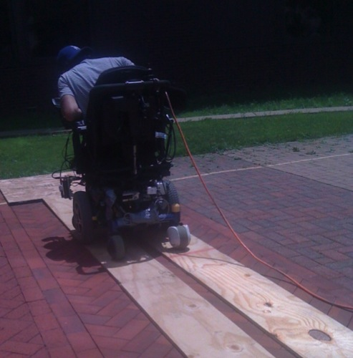
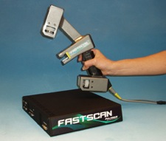
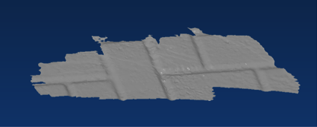
Prototype Instrumentation
Instrumented Wheelchair
Laser Scanner
Notes:
This work was performed during Y1 of the A/B grant

Slide 26

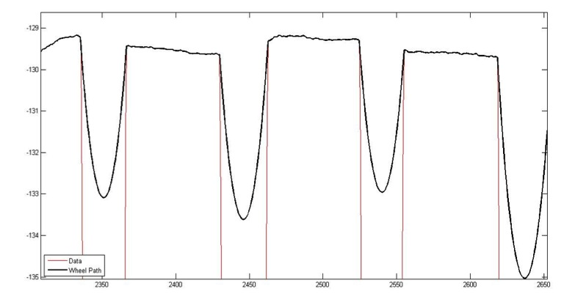
Algorithm Work
Sidewalk Roughness Index (in/ft)
  Summed vertical deviations for a given horizontal distance
A wheel path algorithm developed to determine vertical motion of a wheel (x diameter) surface profile

Slide 27
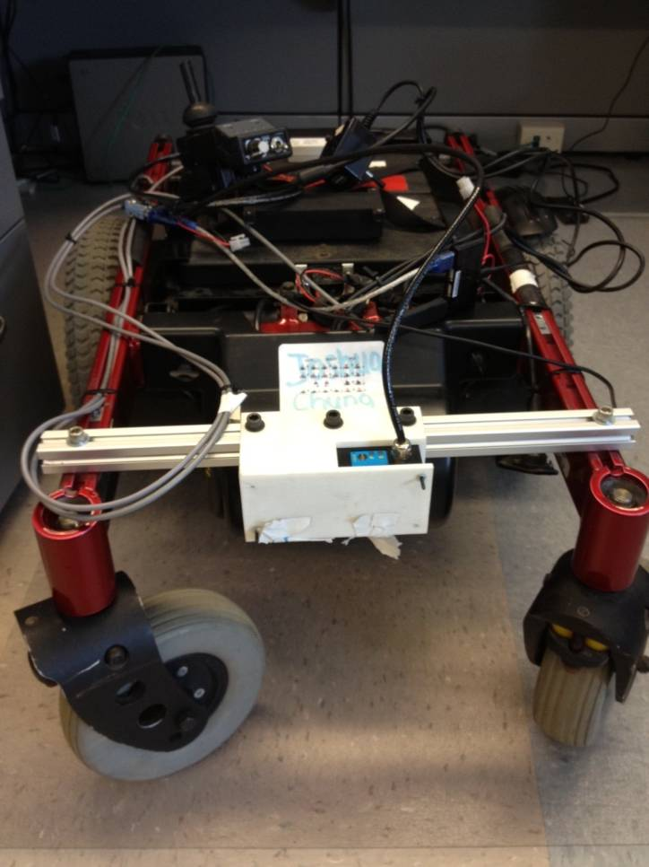
PathMET (1.0)
power-wheelchair base
  Walk-behind
  High-resolution laser (<1mm)
  Encoder on wheels
System is sufficient for A/B study, but may not easily be translatable industry use

Slide 28
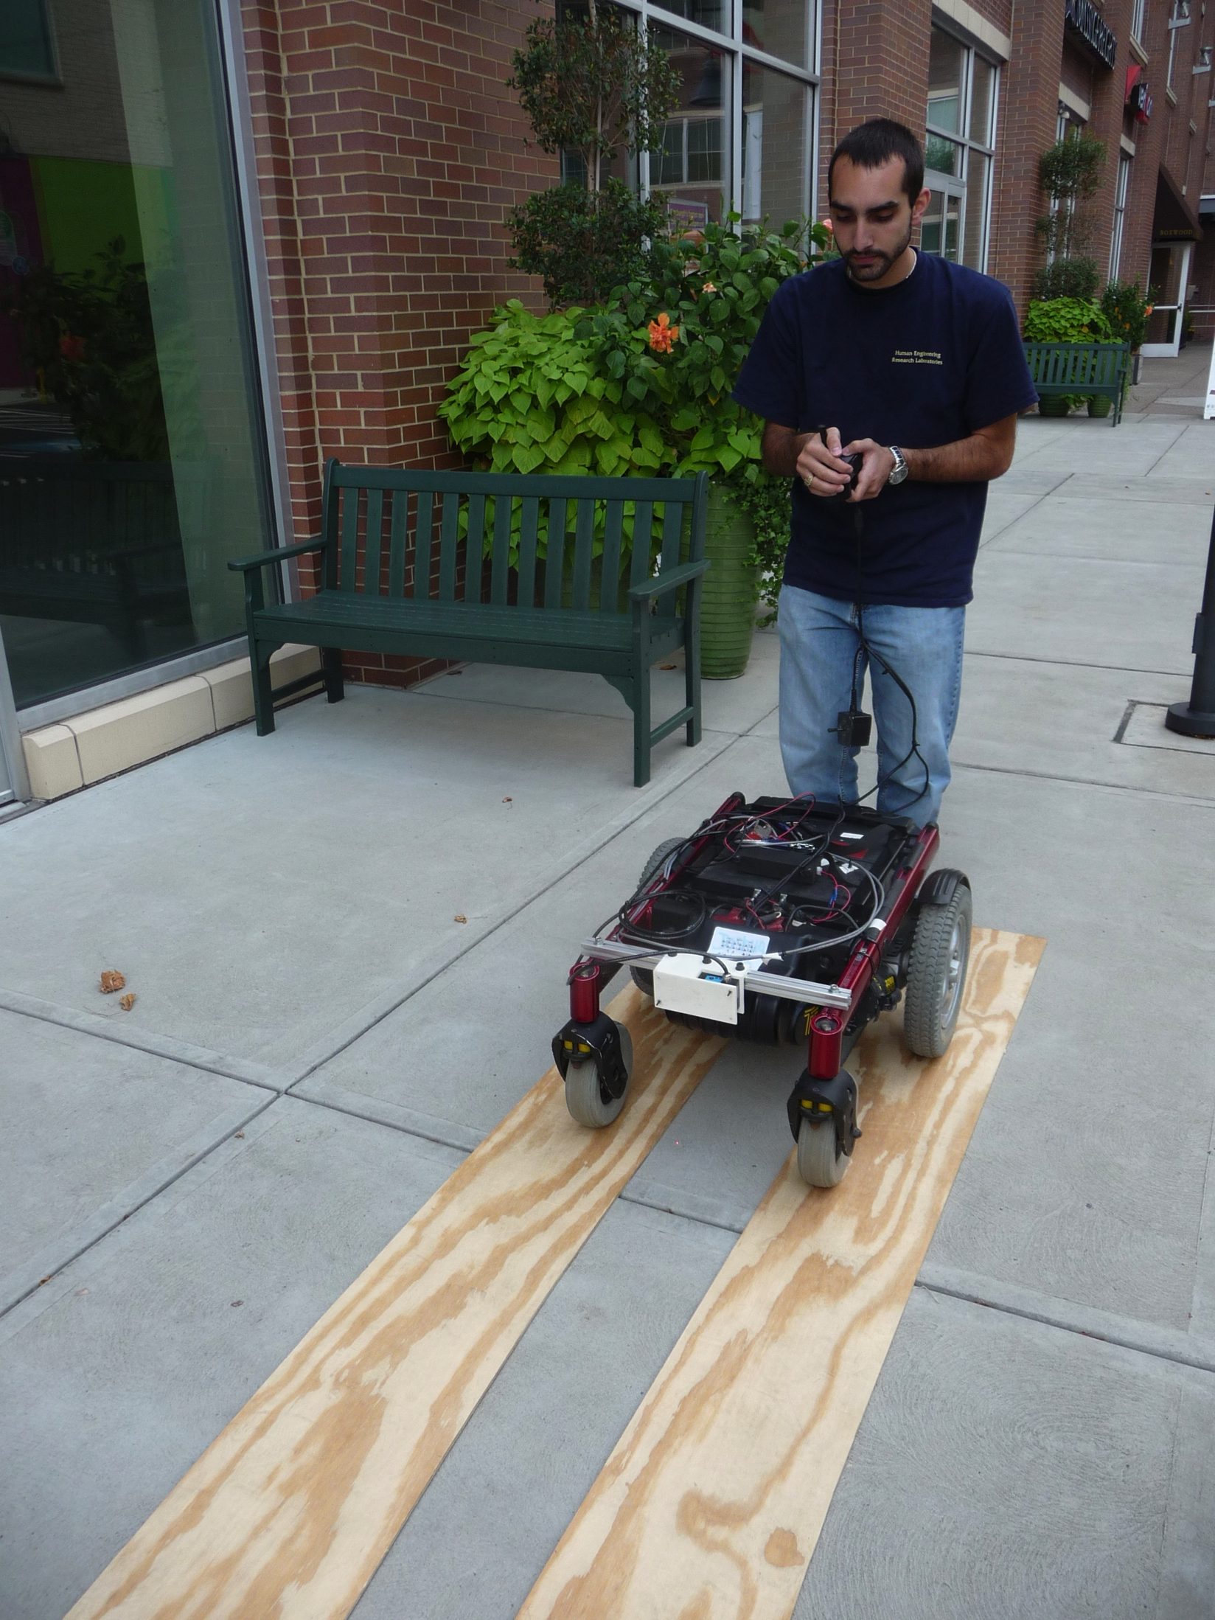
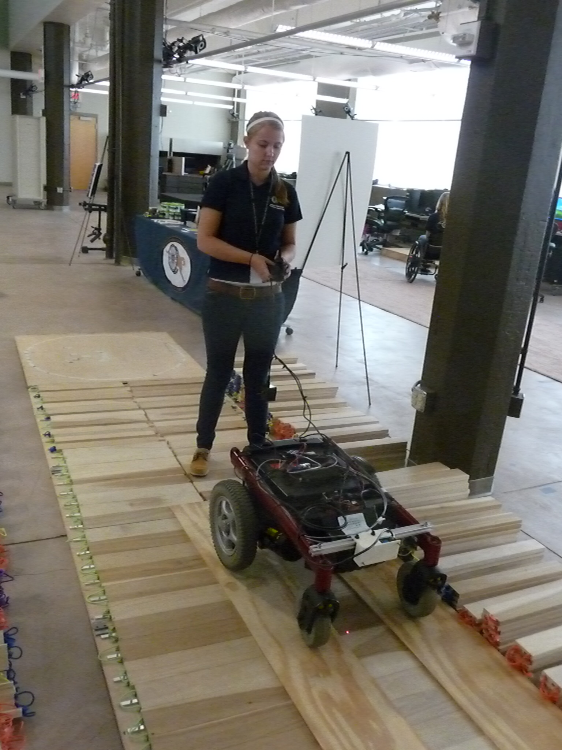
PathMET Data Collection
Notes:
This is a slow task, given the wood rails

Slide 29
PathMET Work
Development of a Pathway Measurement Tool (PathMET), Funded by ICPI/BIA.
Basic Timeline (12 Month)
  Aug: Project Initiated
  Now: ongoing design work
  Dec: Hardware and Software Design Review
  April: Fabrication and Basic Testing Complete
  June: Final Validation Complete
  August: Final report, Find Commercial Partner

Slide 30
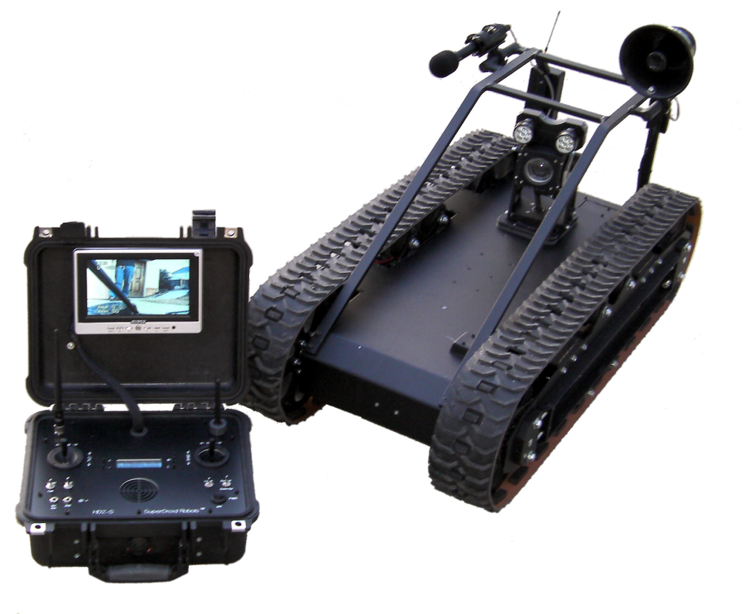
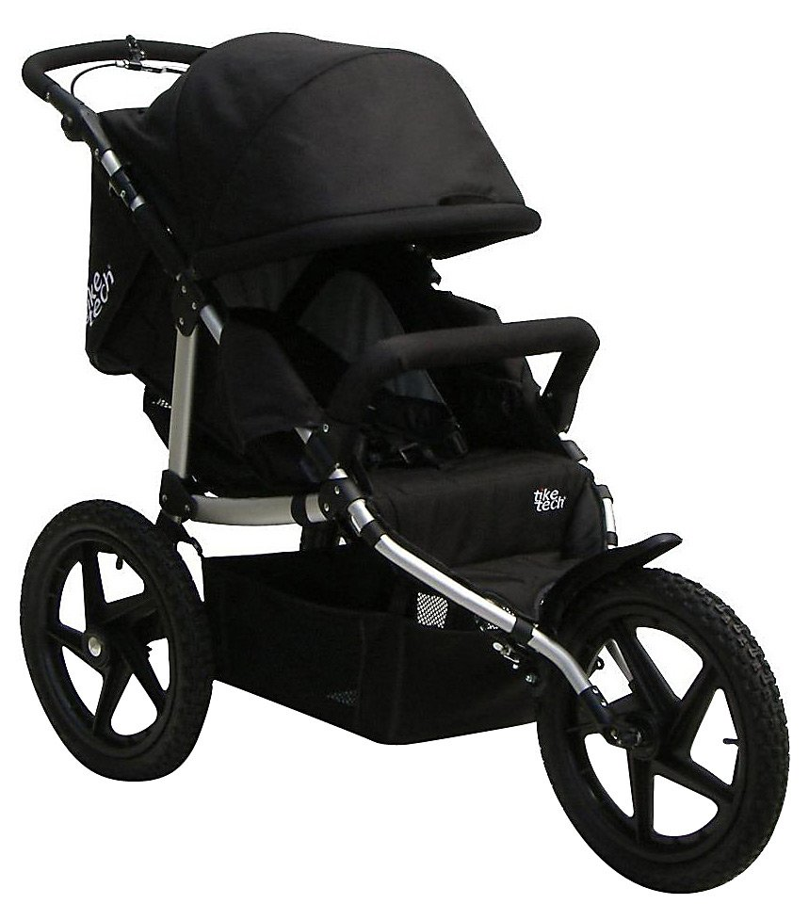
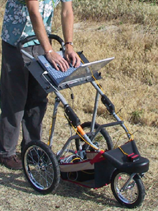
Exploring Mechanical Design

Slide 31
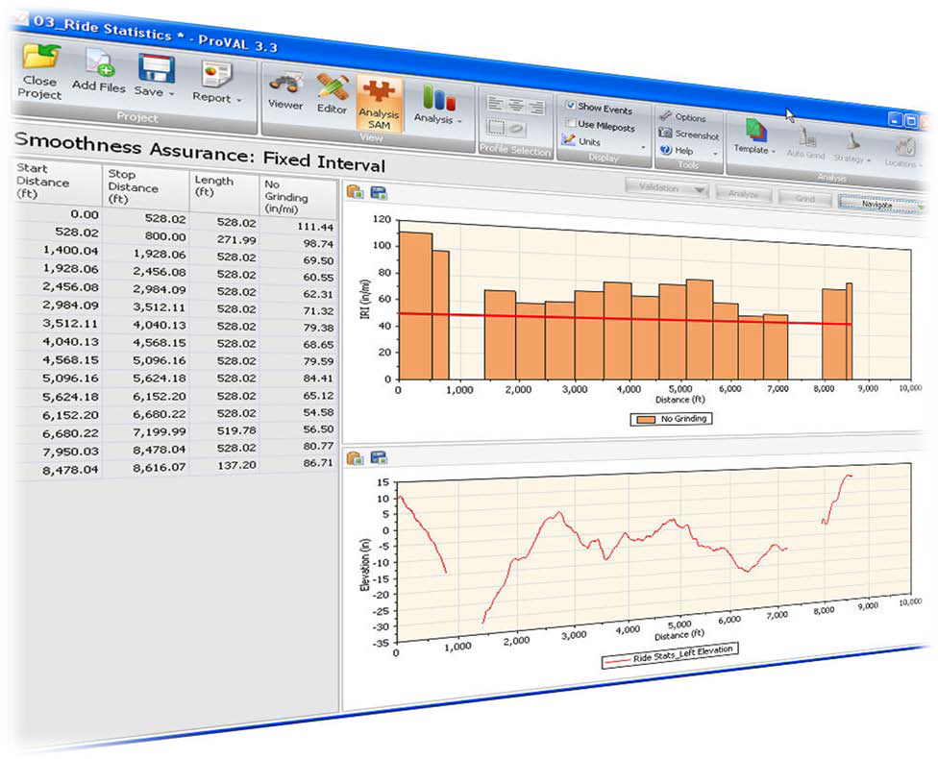
Software Integration: ProVAL

Slide 32
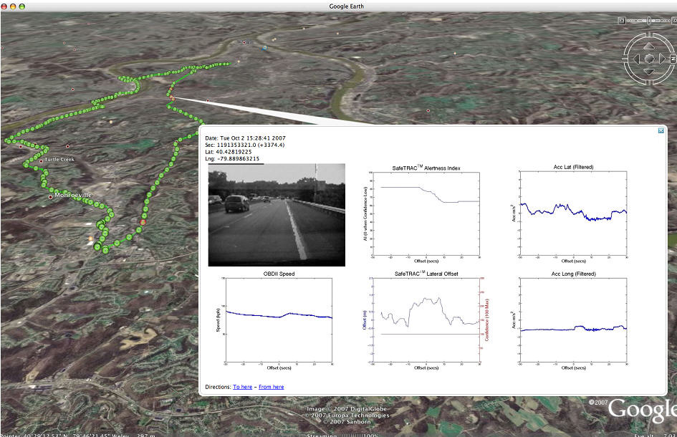
Software Integration: Google Maps

Slide 33
My Questions…
Potential commercial partners for PathMET?
Can ProVAL be modified to analyze our data?
Can we integrate sidewalk roughness into pavement management systems?
Notes:
Eric’s Questions:
Who is going to be using PathMeT?
-young/old?
-technical background?
What sidewalk incongruities (root caused cracks, brick movement, etc.) are most common?
At what time of the day would you typically use PathMeT to measure sidewalks?
Do you perform sidewalk installations year-round?
What types of sidewalks do you typically install? (brick/concrete/pressed brick)
Where do you typically install sidewalks? (residential/city)
What do you think are the greatest weaknesses of current roughness measurement techniques?
How do you currently assess sidewalk roughness?
-What is the process?
-What factors influence your decision to reinstall a sidewalk?
What do you think are the greatest weaknesses of current roughness measurement techniques?
Do you imagine surface roughness measuring to be a 1 man or 2 man job?
How fast are you looking to “measure” a sidewalk?
How much of a sidewalk are you looking to “measure”?
What size segments of sidewalk are normally installed?
Do you have a general size in mind for PathMeT?
What type of computer background will PathMeT users have?
Are there any computer programs that PathMeT users are most comfortable with?
What are some other tools you currently use?
How long does it take to install a typical block of sidewalk?

Slide 34
Acknowledgements & Questions
Funding: Access Board, Dept. of Ed, VA, & ICPI/BIA
Students: Jon Duval, Diana Stuckey, Eric Sinagra
Staff: Emily Teodorski, Josh Brown, Zack Mason, Mark McCartney

