Slide 2
Compact Terrain Characterization
Background
  Surface Creation - Curved Regular Gridding
  Surface Decompositions
    Components: Elevation, Banking, Rutting, Crowning…
    Frequency ranges
  Modeling Surface Components
Compact Terrain Characterization
  Defining model parameter vector
  Reducing parameter space
  Proof of Concept
Future Work and Conclusions

Slide 3
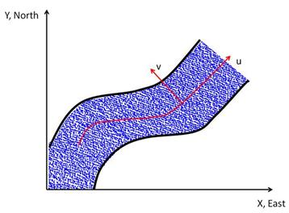
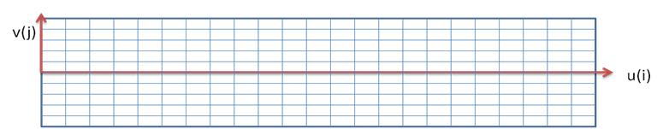
Creating Curved Regular Grid (CRG)
Measured data is point cloud of irregularly spaced x-y-z data
Define path coordinate, u
Define perpendicular and coordinate, v
(u,v) is then a Regularly Spaced Grid, or “Curved Regular Grid” (CRG) for horizontal plane
CloudSurfer converts
point cloud to a CRG automatically
Chemistruck*, H. M., Binns*, R., Ferris, J.B., 2010, “Correcting INS Drift in Terrain Surface Measurements” Journal of Dynamic Systems Measurement and Control. Vol. 133, No. 2 (DOI:10.1115/1.4003098).

Slide 4
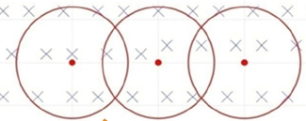

Determining height at each CRG node
v(j)
Consider a CRG node
(red dot)
In estimating the CRG node heights, the measured data points (blue x’s) closest to CRG nodes are more influential than those further away
Influence of node height is based on weighting function that takes into account (d_{i}) and error in the horizontal measurements (σ)
u(i)
d₂
d₁
Ma*, R., Ferris, J.B., 2011, “Terrain Gridding Using a Stochastic Weighting Function,” Proceedings of the ASME Dynamic Systems and Control Conference, October 31 – November 2, Arlington, Virginia

Slide 5
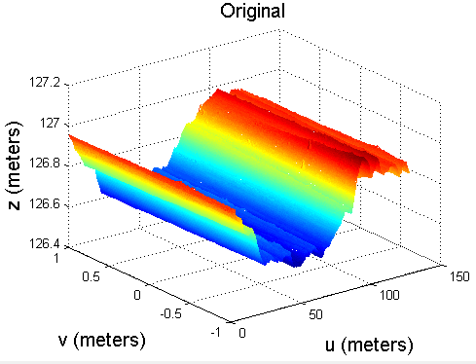
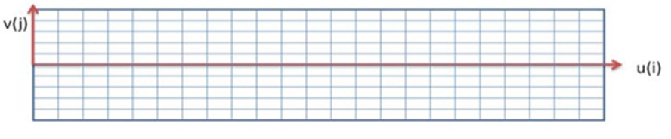
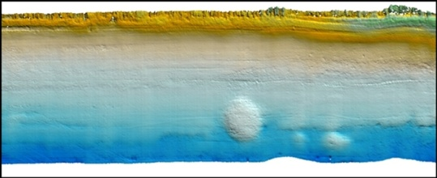
Surface Creation
A probability distribution of the height at each CRG node is created
Consider the median height values represent surface
Final surface can be imported into software (e.g. Adams)
  Ride Simulation
Surface: collection of…
Longitudinal Profile
Transverse Profile

Slide 6
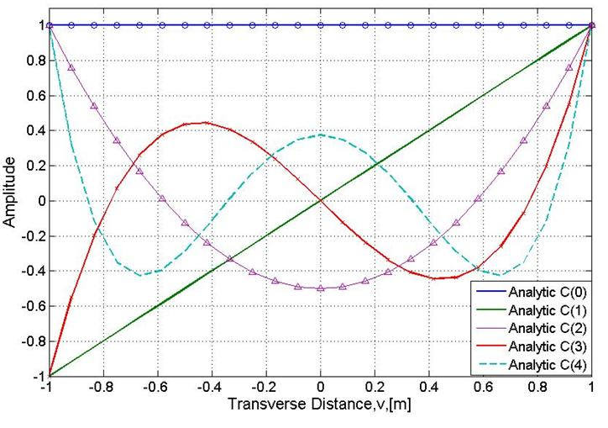
Surface Decomposition
Transverse profiles decomposed into principal components
First 5 Basis Vectors (Legendre Polynomials)
Elevation
Bank Angle
Asymmetry
Road Rutting
Crowning
Chemistruck*, H. M., Ferris, J.B., Gorsich, D., 2012. “Using a Galerkin Approach to Define Terrain Surfaces.” Journal of Dynamic Systems Measurement and Control, Volume 134, Issue 2, 021017 (12 pages) http://dx.doi.org/10.1115/1.4005271

Slide 7
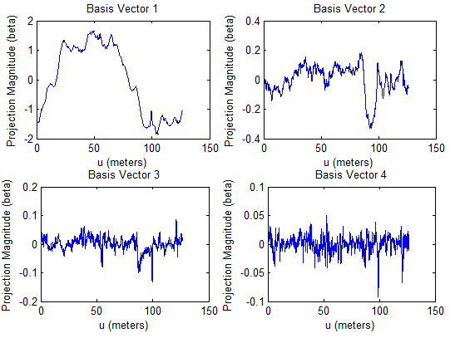
Surface Decomposition
Transverse Profile projected on Basis Vectors yields Components
Elevation
Bank Angle
Crowning
Rutting

Slide 8

Autoregressive Model
Elevation value
at a point
=
Linear combination of previous values +
a residual process
(uncertainty)
z_{k} = [ φ₁ z_{k-1} + φ₂ z_{k-2} + … + φ_{p} z_{k-p} ] + residual
correlation length (p)
z_{k}
Elevation
z_{k} = [ φ₁z_{k-1} + φ₂z_{k-2} + … + φ_{p}z_{k-p} ] + a_{k}
a_{k}
Terrain Profile Data Points
AR models hare parameterized by the φ values
Wagner*, S. M. and Ferris, J. B., 2012, “Residual Analysis of Autoregressive Models of Terrain Topology,” Journal of Dynamic Systems Measurement and Control, Volume 134, Issue 3, 031003 (6 pages) http://dx.doi.org/10.1115/1.4005502.

Slide 9
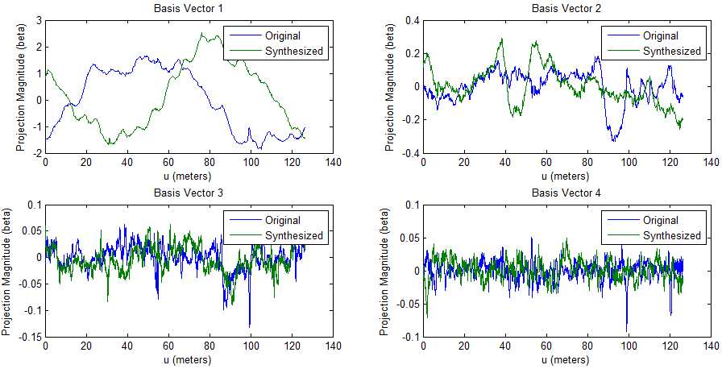
Surface Synthesis
Generating synthetic terrain
  Model each component
  Generate synthetic components with same essential characteristics of measured
Elevation
Bank Angle
Multiply by basis vectors…
Crowning
Rutting

Slide 10
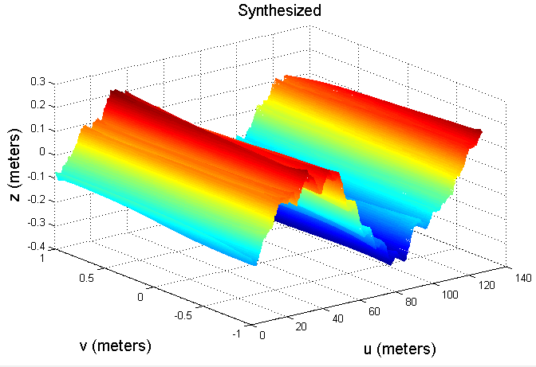
Surface Synthesis
Synthetic components can be synthesized,
then combined to form a synthetic surface
Reconstructed surface is unique but statistically similar to original

Slide 11
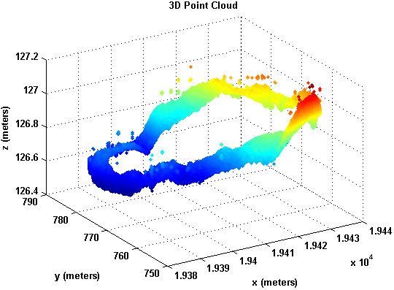
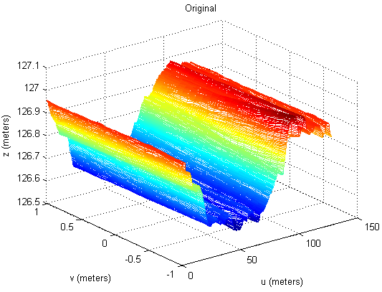
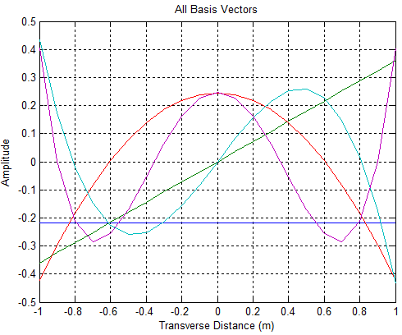
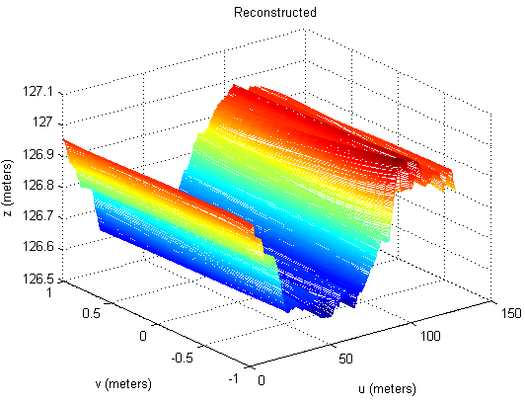
Whew!! Let’s recap with an example…
Typical 100 meter terrain measurement:
  Original point cloud: ~1.2 billion points
  10 mm curved regular grid: ~2 million points
  5 principal components: ~50 thousand points
  10th order AR model of spectrally decomposed components (3 bandwidths): ~200 coefficients
Still too large to hold in your hand…
Can we go a step further?

Slide 12



Defining Model Parameter Vector
Consider a collection of different surfaces, each being indexed by k
Each surface is decomposed into components: elevation, banking,…
Each component is further decomposed into different frequencies (wavelengths)
A unique model is used for each “profile”: AR models are parameterized by φ
Entire set of parameters for $k^{th}$ surface can be held in vector: $p_{k}$
Is there a pattern across different surfaces?
Surface $k$
Surface
Component 1
Surface
Component 2
Frequency
Bandwidth 1
Frequency
Bandwidth 2
Frequency
Bandwidth 3
Frequency
Bandwidth 1
Frequency
Bandwidth 2
Frequency
Bandwidth 3
Model coef.
Model coef.
Model coef.
Model coef.
Model coef.
Model coef.
$$p_{k}$$

Slide 13
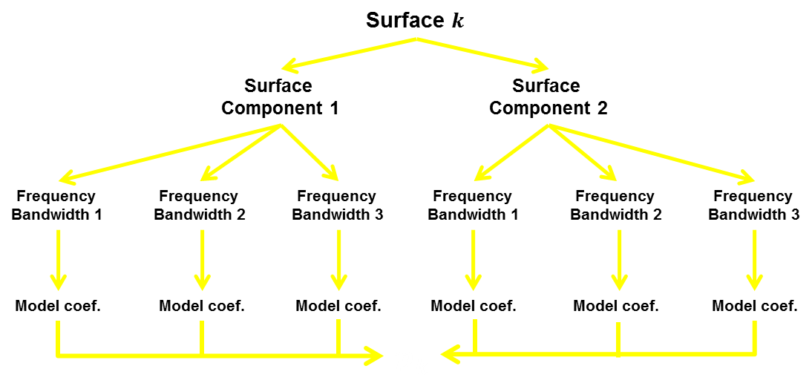





Reducing Parameter Space
Obtain diverse and extensive surfaces (k = 1, 2, 3,… $n_{s}$)
Decompose and model each surface and obtain a model parameter vector, p_{k}, for each surface
Combine all parameter vectors into a single matrix, P
Find principal patterns in the parameter vectors using Singular Value Decomposition (SVD)
Keep the 3 “most important” basis vectors: q₁, q₂, q₃
$$p_{k}$$
$$P=\left[p_{1} p_{2}…p_{n_{s}}\right]$$
$$SVD$$
$q_{1}^{},q_{2}^{},q_{3}^{}$… $q_{n_{s}}^{}$

Slide 14






Approach: Project on Basis Vectors
$$p=\left[\begin{matrix}p_{1} \\ p_{2} \\ p_{3} \\ ⋮ \\ p_{72}\end{matrix}\right]$$
Consider surface modeled with 72 parameters
Estimate parameters using basis vectors
Knowing the basis vectors, written compactly as only the 3 “$a$” coefficients are needed to characterize the surface
$$p≈a_{1}q_{1}+a_{2}q_{2}+a_{3}q_{3}$$
$$p≈\left[q_{1} q_{2} q_{3}\right]\left\{\begin{matrix}a_{1} \\ a_{2} \\ a_{3}\end{matrix}\right\}$$
$$Q=\left[q_{1} q_{2} q_{3}\right]$$
Characterization Coefficients
$$p\underset{→}{projected}Q→a_{1} a_{2} a_{3}$$

Slide 15










Approach: Big Picture
Diverse set of surfaces
Model
$$p_{1}$$
Surface to characterize
Model
$$p_{new}$$
Model
$$p_{2}$$
$$q_{1}$$
$$q_{2}$$
$$q_{3}$$
Projection
$$Q$$
Model
$$SVD$$
$$p_{3}$$
Model
$$p_{4}$$
$$a_{1} a_{2} a_{3}$$
Model
$$p_{5}$$

Slide 16
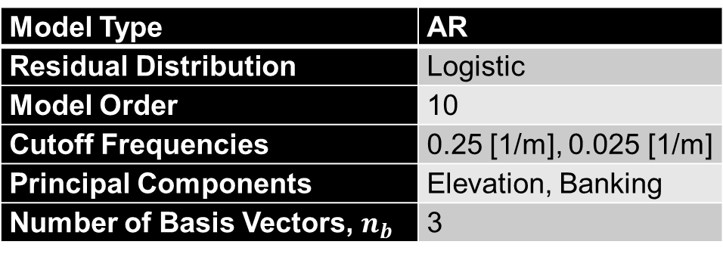
Proof of Concept: Model Choice
Several surfaces are modeled using settings below
Profiles from each surface are plotted and compared to the synthetic profiles using the characteristic coefficients
Model Type | AR
Residual Distribution | Logistic
Model Order | 10
Cutoff Frequencies | 0.25 [1/m], 0.025 [1/m]
Principal Components | Elevation, Banking
Number of Basis Vectors, $n_{b}$ | 3

Slide 17
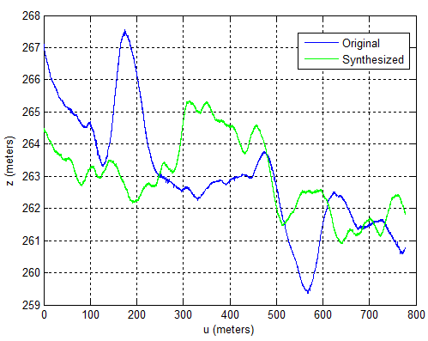
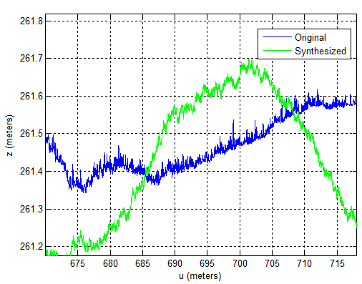


Proof of Concept: Results
Profile 1
$$a_{1}=−3.016 \\ a_{2}=1.009 \\ a_{3}=−1.546$$

Slide 18
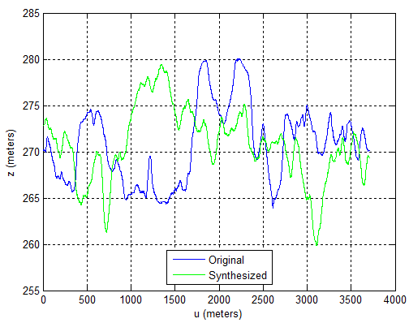
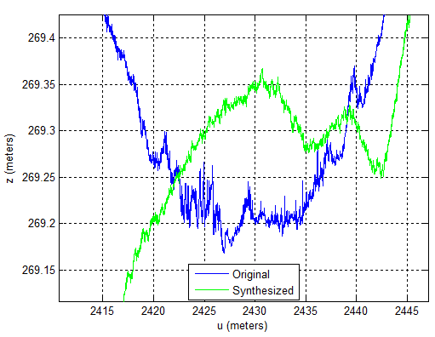


Proof of Concept: Results
Profile 2
$$a_{1}=−2.365$$
$$a_{2}=−.938$$
$$a_{3}=.813$$

Slide 19
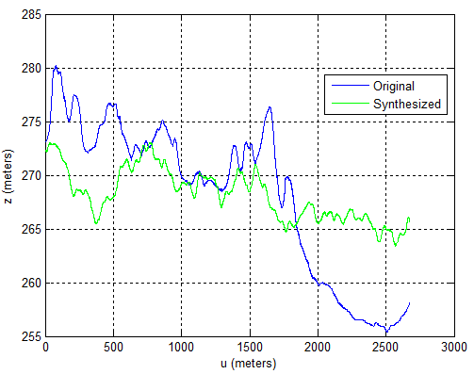
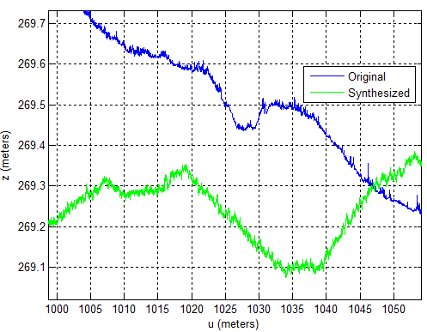

Proof of Concept: Results
Profile 3
$$a_{1}=−2.682$$
$a_{2}=$.985
$$a_{3}=−.548$$

Slide 20
Future Work
Concept must be applied to roads outside the set used for SVD
A more complete and diverse road set is needed to finalize SVD
Separate models must be investigated
  Model type: AR, CMC, Hybrid, etc.
  Frequency bandwidths
  Surface principal components
  Model order
  Characteristic distribution for residuals (Logistic, Normal, Cauchy, etc.)
Portability between models
(same characteristic coefficients for multiple models)
Physical interpretation of coefficients
Techniques to avoid model instability

Slide 21
Conclusions
Preliminary results are very encouraging
Characterization must be applied to new courses outside SVD set
Numerous modeling choices to be researched
Thanks!

