Slide 1
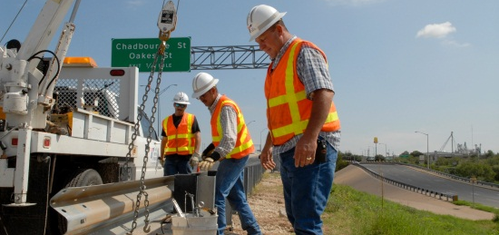
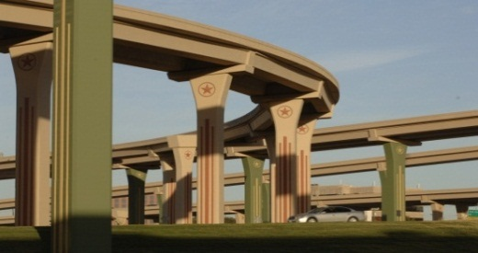


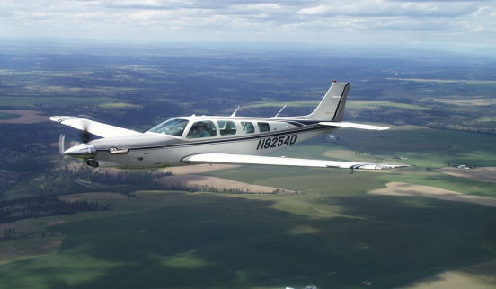


Use Ground Penetrating Radar Technology to Evaluate Rutting in An Asphalt Overlay
Feng Hong, PE, PhD, TxDOT
Darhao Chen, PE, PhD, TxDOT
September 16~19, 2013, RPUG Meeting, San Antonio, TX

Slide 2
Table of Contents
1
Introduction
3
2
Background
4-6
3
Experimental Design
7
4
Nondestructive Testing with GPR
8-16
5
Trench Verification
17-18
6
Conclusion Remarks
19

Slide 3
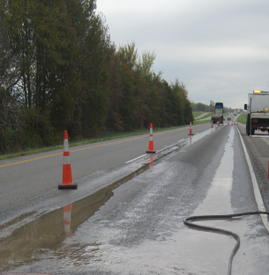
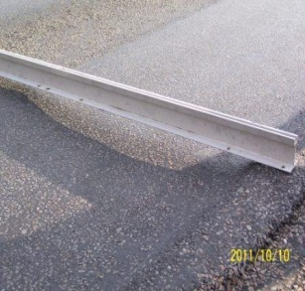
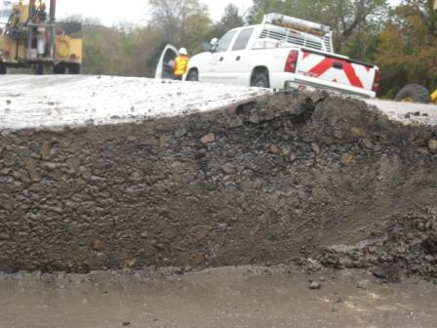
Introduction
What is rut
Causes of rut
Layer-based rut study
Methods to evaluate layer-based rut
Focus of this study

Slide 4
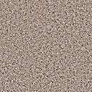



Background (1)
Pavement structure
Project history
Hot rubber seal: 2006
Hot mix asphalt overlay: 1998
Hot rubber seal
~2” TyC HMA
~4~5” TyB HMA
Seal coat
~8” CRC
Fabric underseal
Traffic
2010 AADT: 24610
Truck percentage: 26%
20 years ESALs: 33 million
~6” CTB
Subgrade

Slide 5
Background (2)

Slide 6
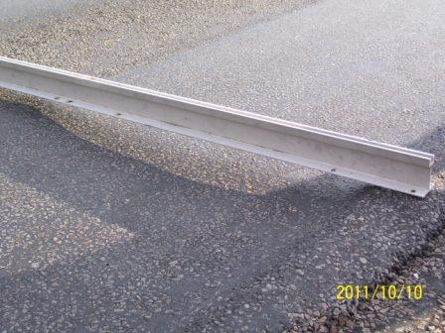
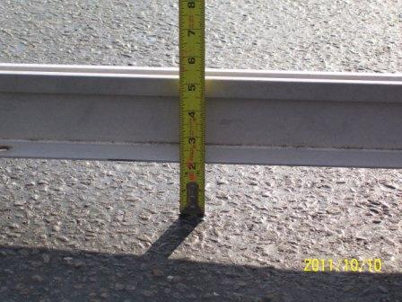
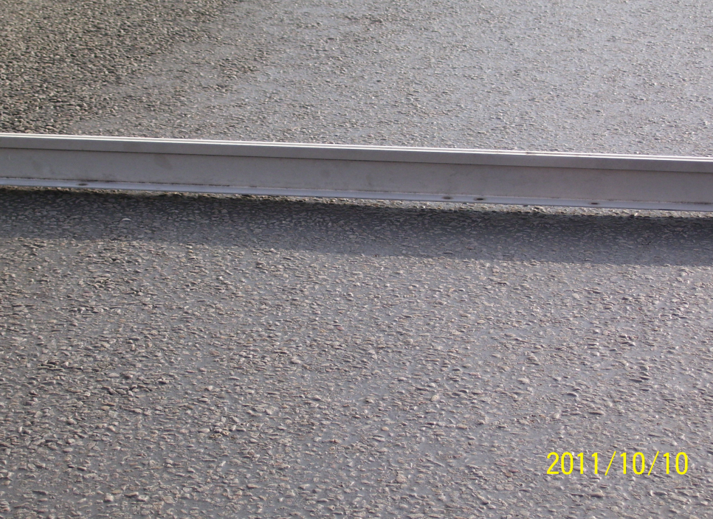
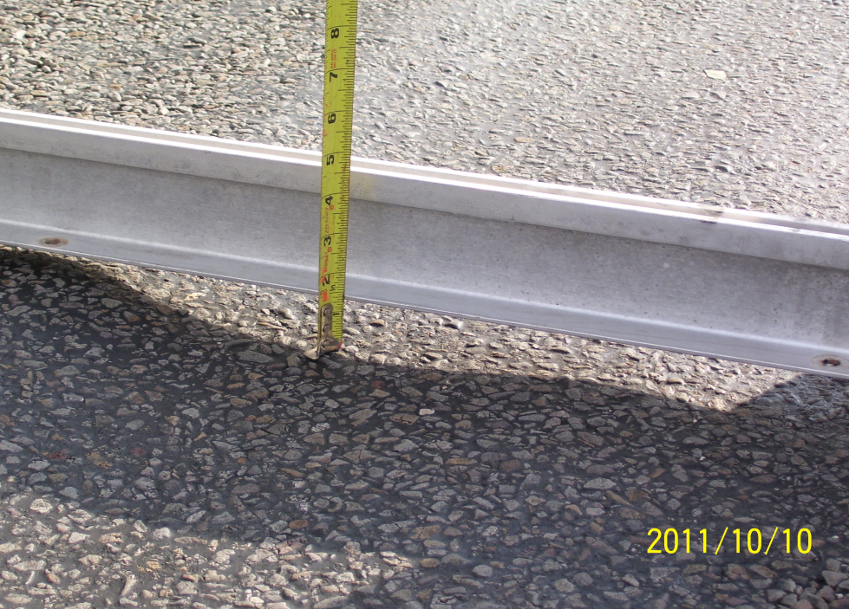
Background (3)

Slide 7
Experimental Design
Non destructive testing
Destructive testing
Ground Penetrating Radar used to estimate pavement layer thickness
  Right wheel path
  Middle of lane
Coring used to calibrate GPR thickness estimates
Trenching used to verify permanent deformation estimated by GPR
NDT and DT complement each other to accommodate evaluation of permanent deformation across the entire length of the segment under study.

Slide 8
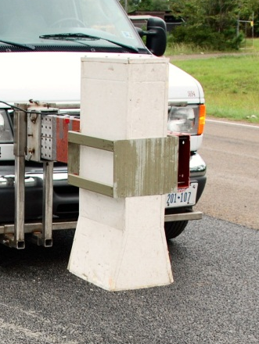
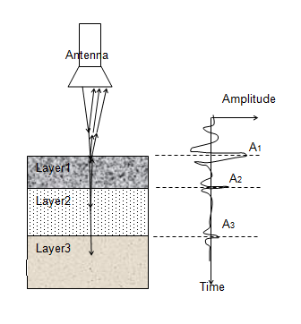
GPR Principle
Pavement

Slide 9
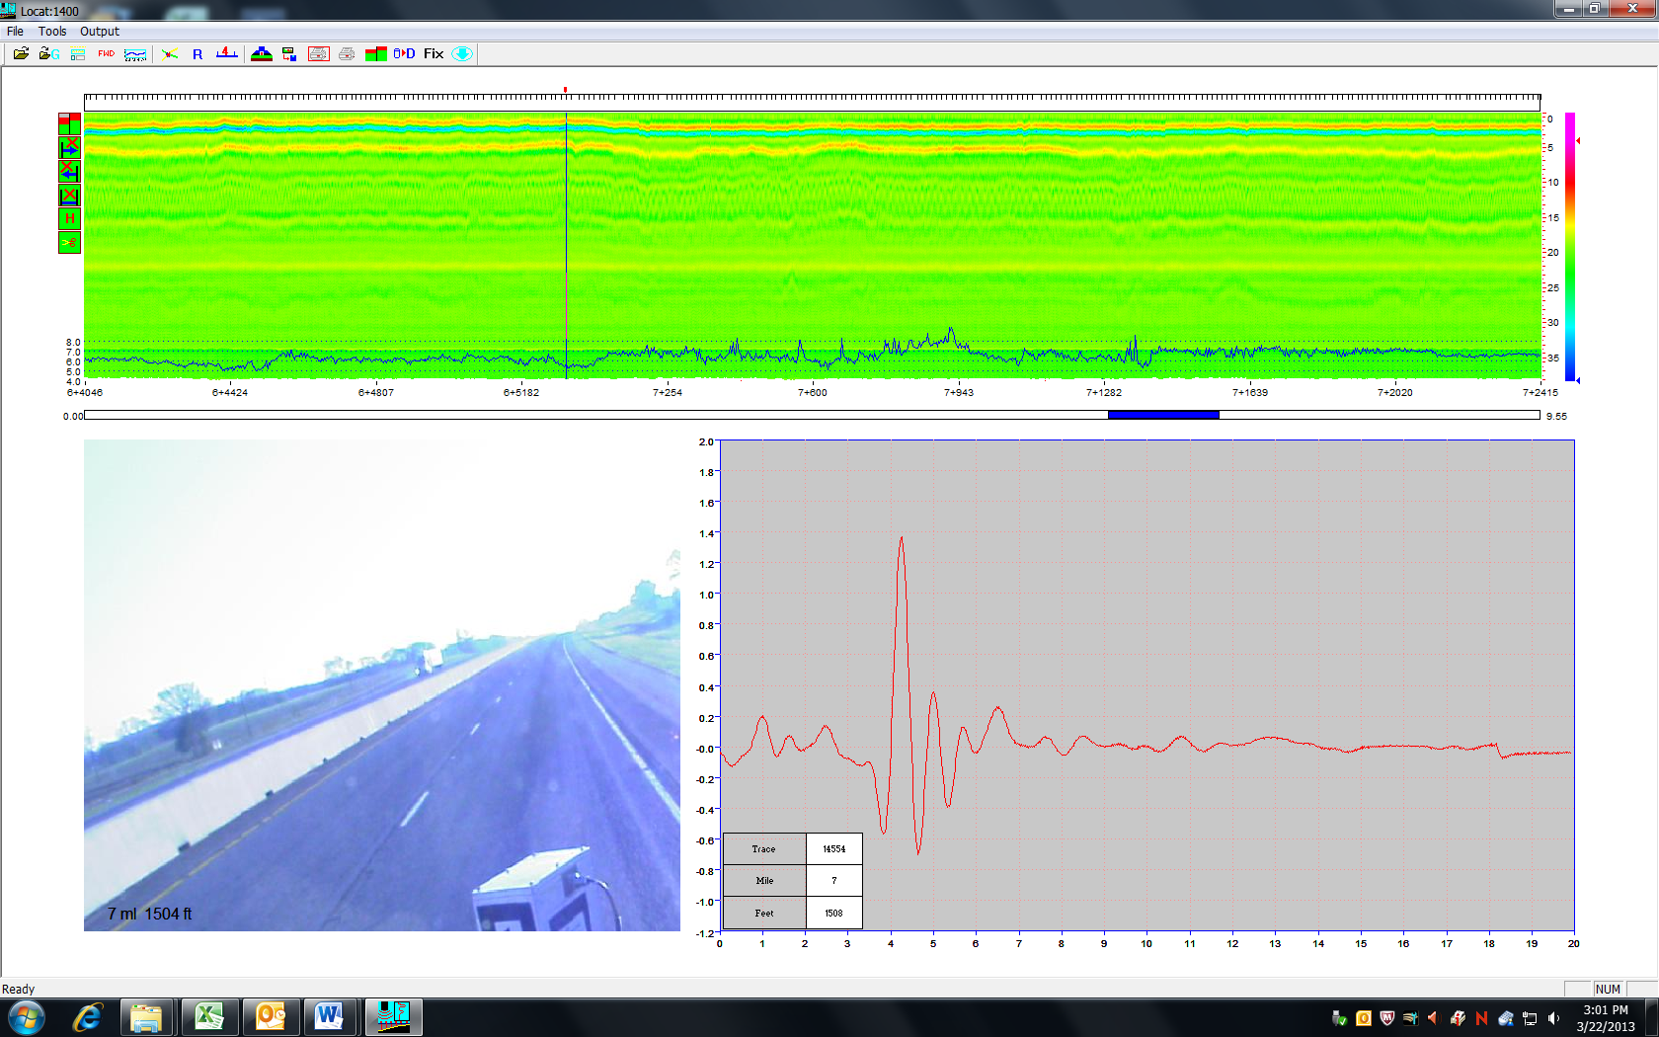
GPR Colorful Map View

Slide 10
Thickness Estimation Based on GPR Signal
Dielectric
A₁: Amplitude of reflection from pavement surface, in volt;
A_{m}: Amplitude of reflection from a metal plate (placed on a pavement surface), in volt.
Thickness
c: A constant representing the speed of the EM wave traveling in the air, i.e. approximately 3x108 m/s or 11.8 inch/ns; and
t: One way travel time of an EM wave in a given layer.

Slide 11
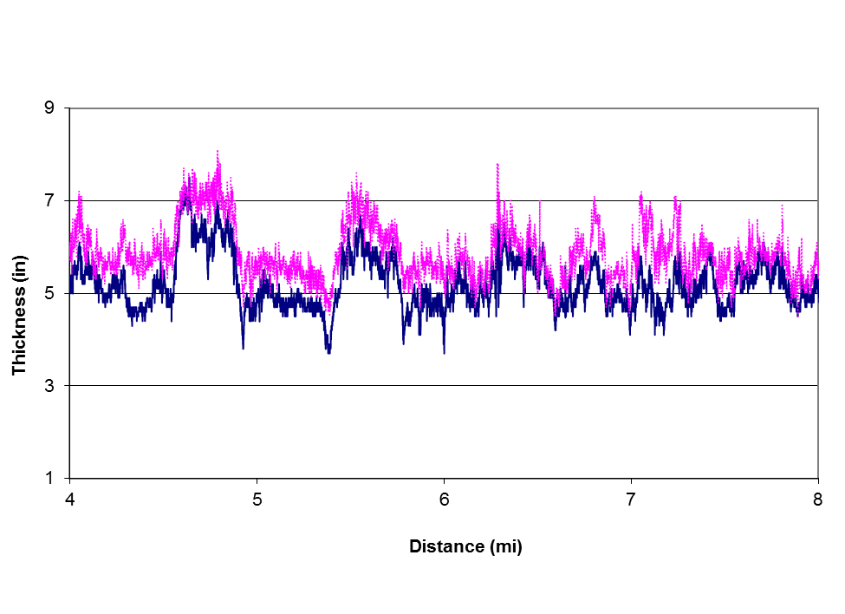
Total AC Overlay Thickness
Middle of Lane
Right Wheel Path

Slide 12
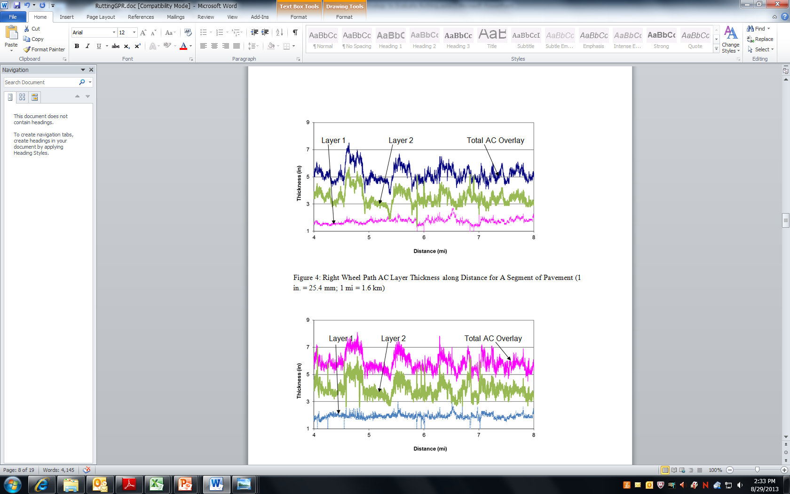
AC Layer Thickness Along Different Scan Lines
Right Wheel Path
Middle of Lane

Slide 13
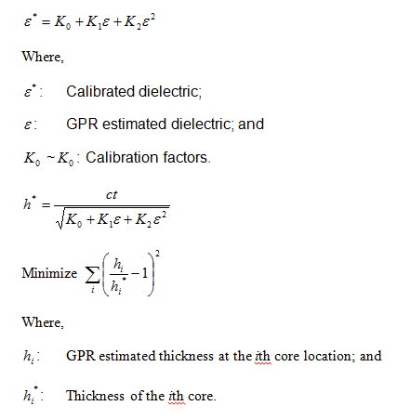
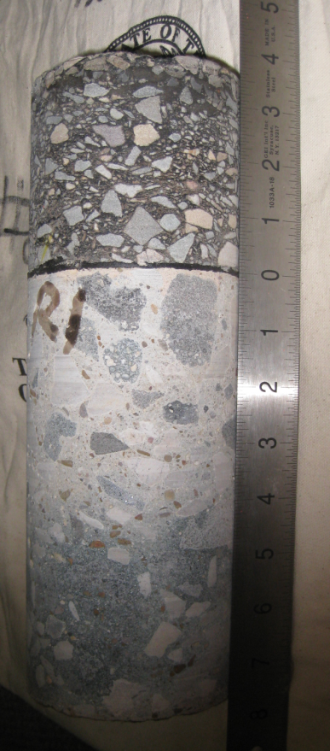
Thickness Calibration

Slide 14
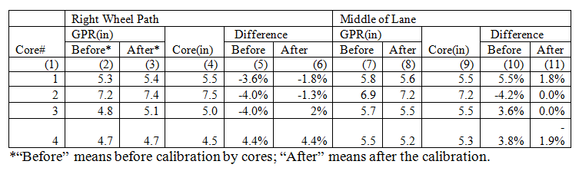
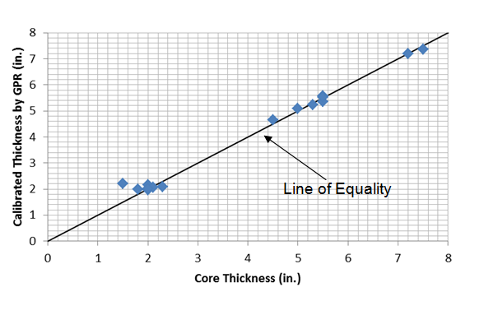
Calibration Results

Slide 15
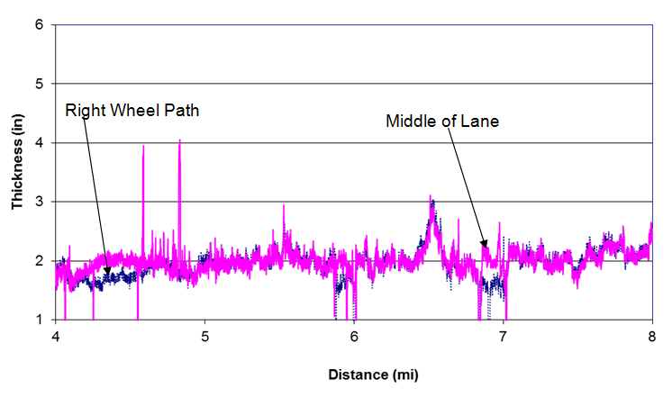
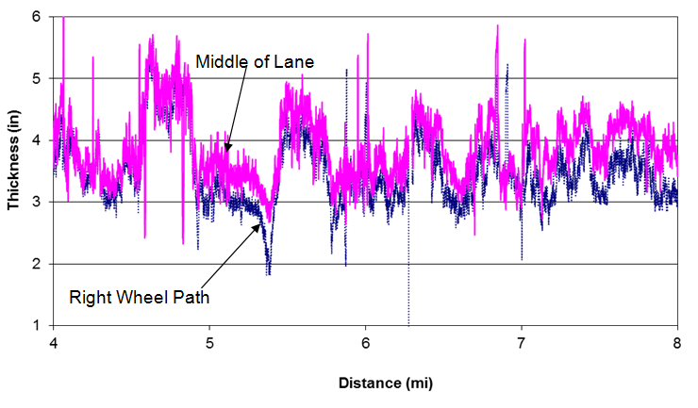
Layer Based Thickness Comparison
AC Layer 1
AC Layer 2

Slide 16
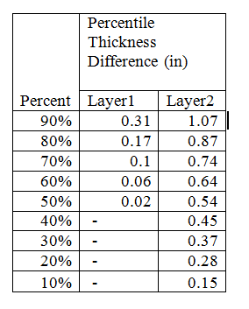
Layer Based Permanent Deformation Statistics

Slide 17
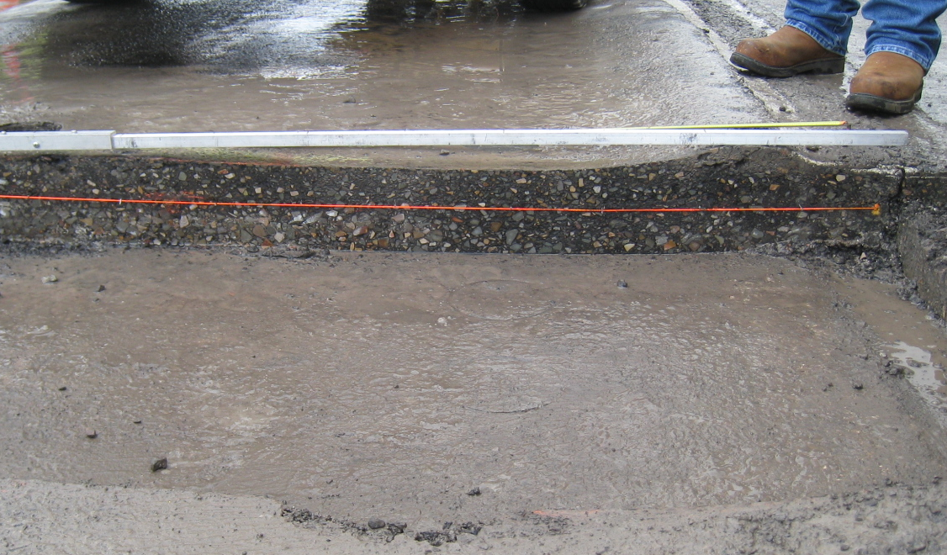
Trenching in Field

Slide 18
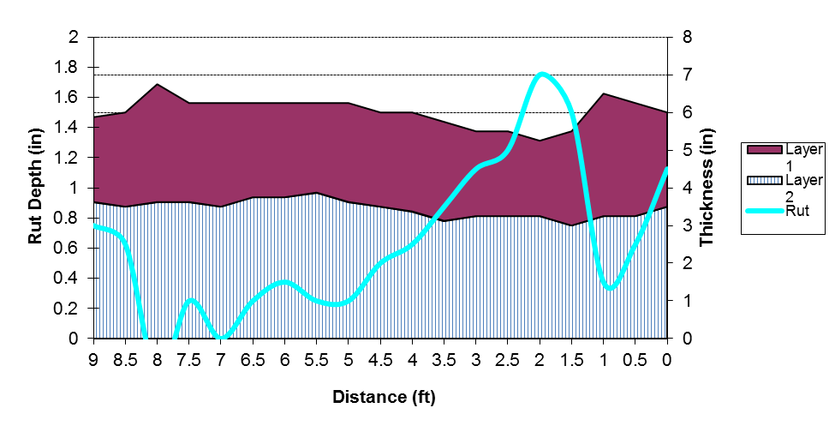
Permanent Deformation from Trench
PD (in.) | GPR | Trench
Layer 1 | 0.63 | 0.63
Layer 2 | 0.27 | 0.38

Slide 19
Conclusion Remarks
GPR can serve as an effective tool to
  Evaluate permanent deformation in AC overlay
  Identify layer-based permanent deformation
  Provide full length survey coverage
  Provide fast and nondestructive survey results

Slide 20
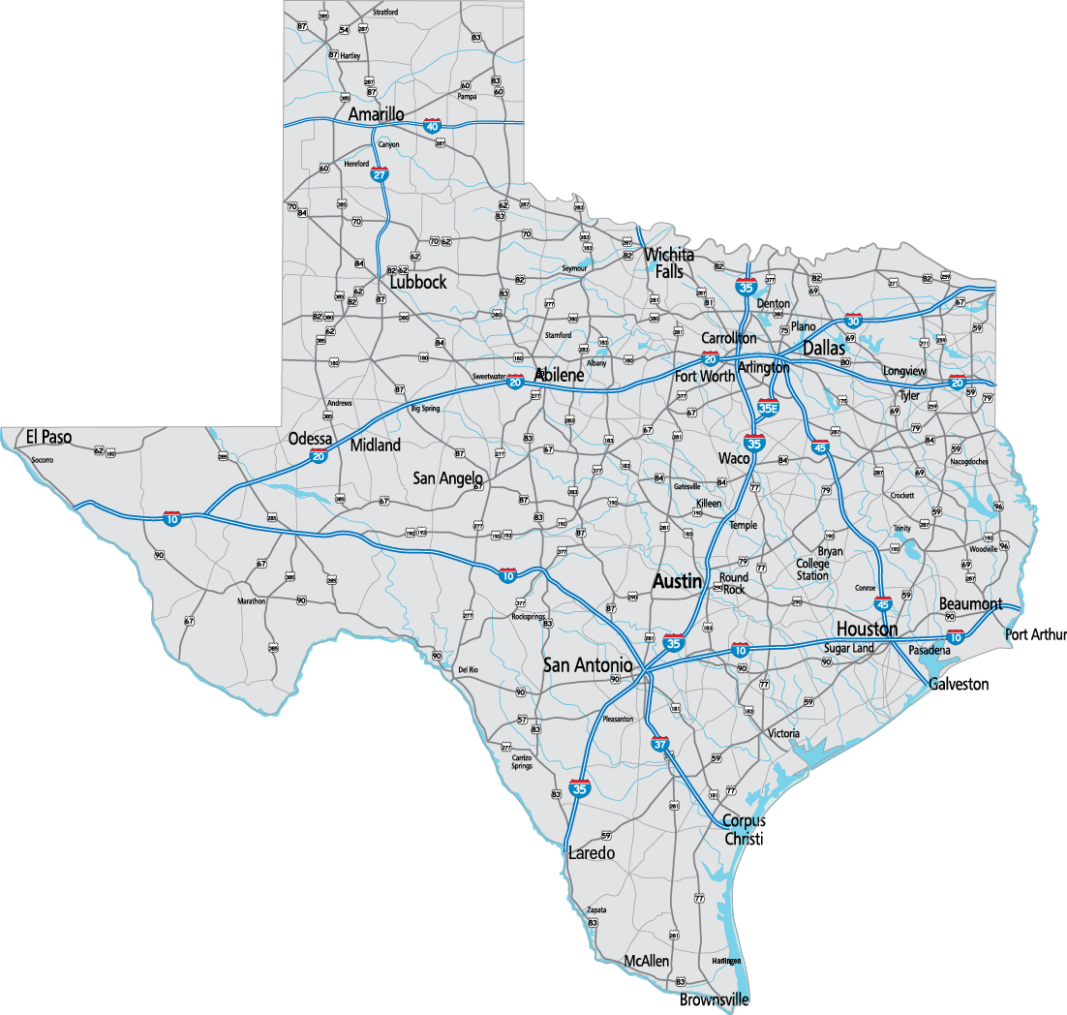
Thank You
&
Be Safe

